Slide 1
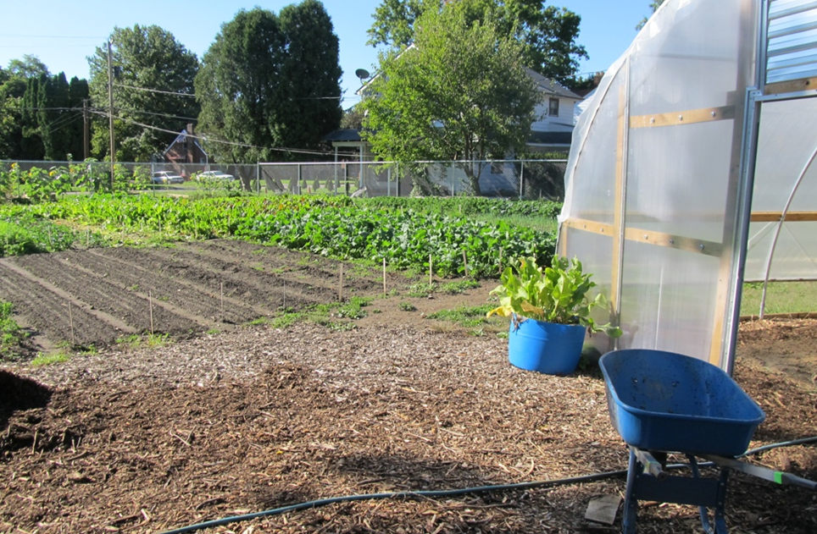
MODULE 1:
Introduction to small-scale farming systems and soil health
Notes:
This module will kick off our training on soil health for small-scale and urban agriculture. This presentation will get us started by looking at some basic considerations about small-scale and urban farms, looking at how working with small farms may be unique for NRCS, and exploring some examples of soil health management at small scales. We will do a short run through of our agenda for the training. We will end by introducing the group assignments that everyone will be working on throughout the training.
Photo: Josh Beniston, NRCS – urban farm in Youngstown, OH

Slide 2
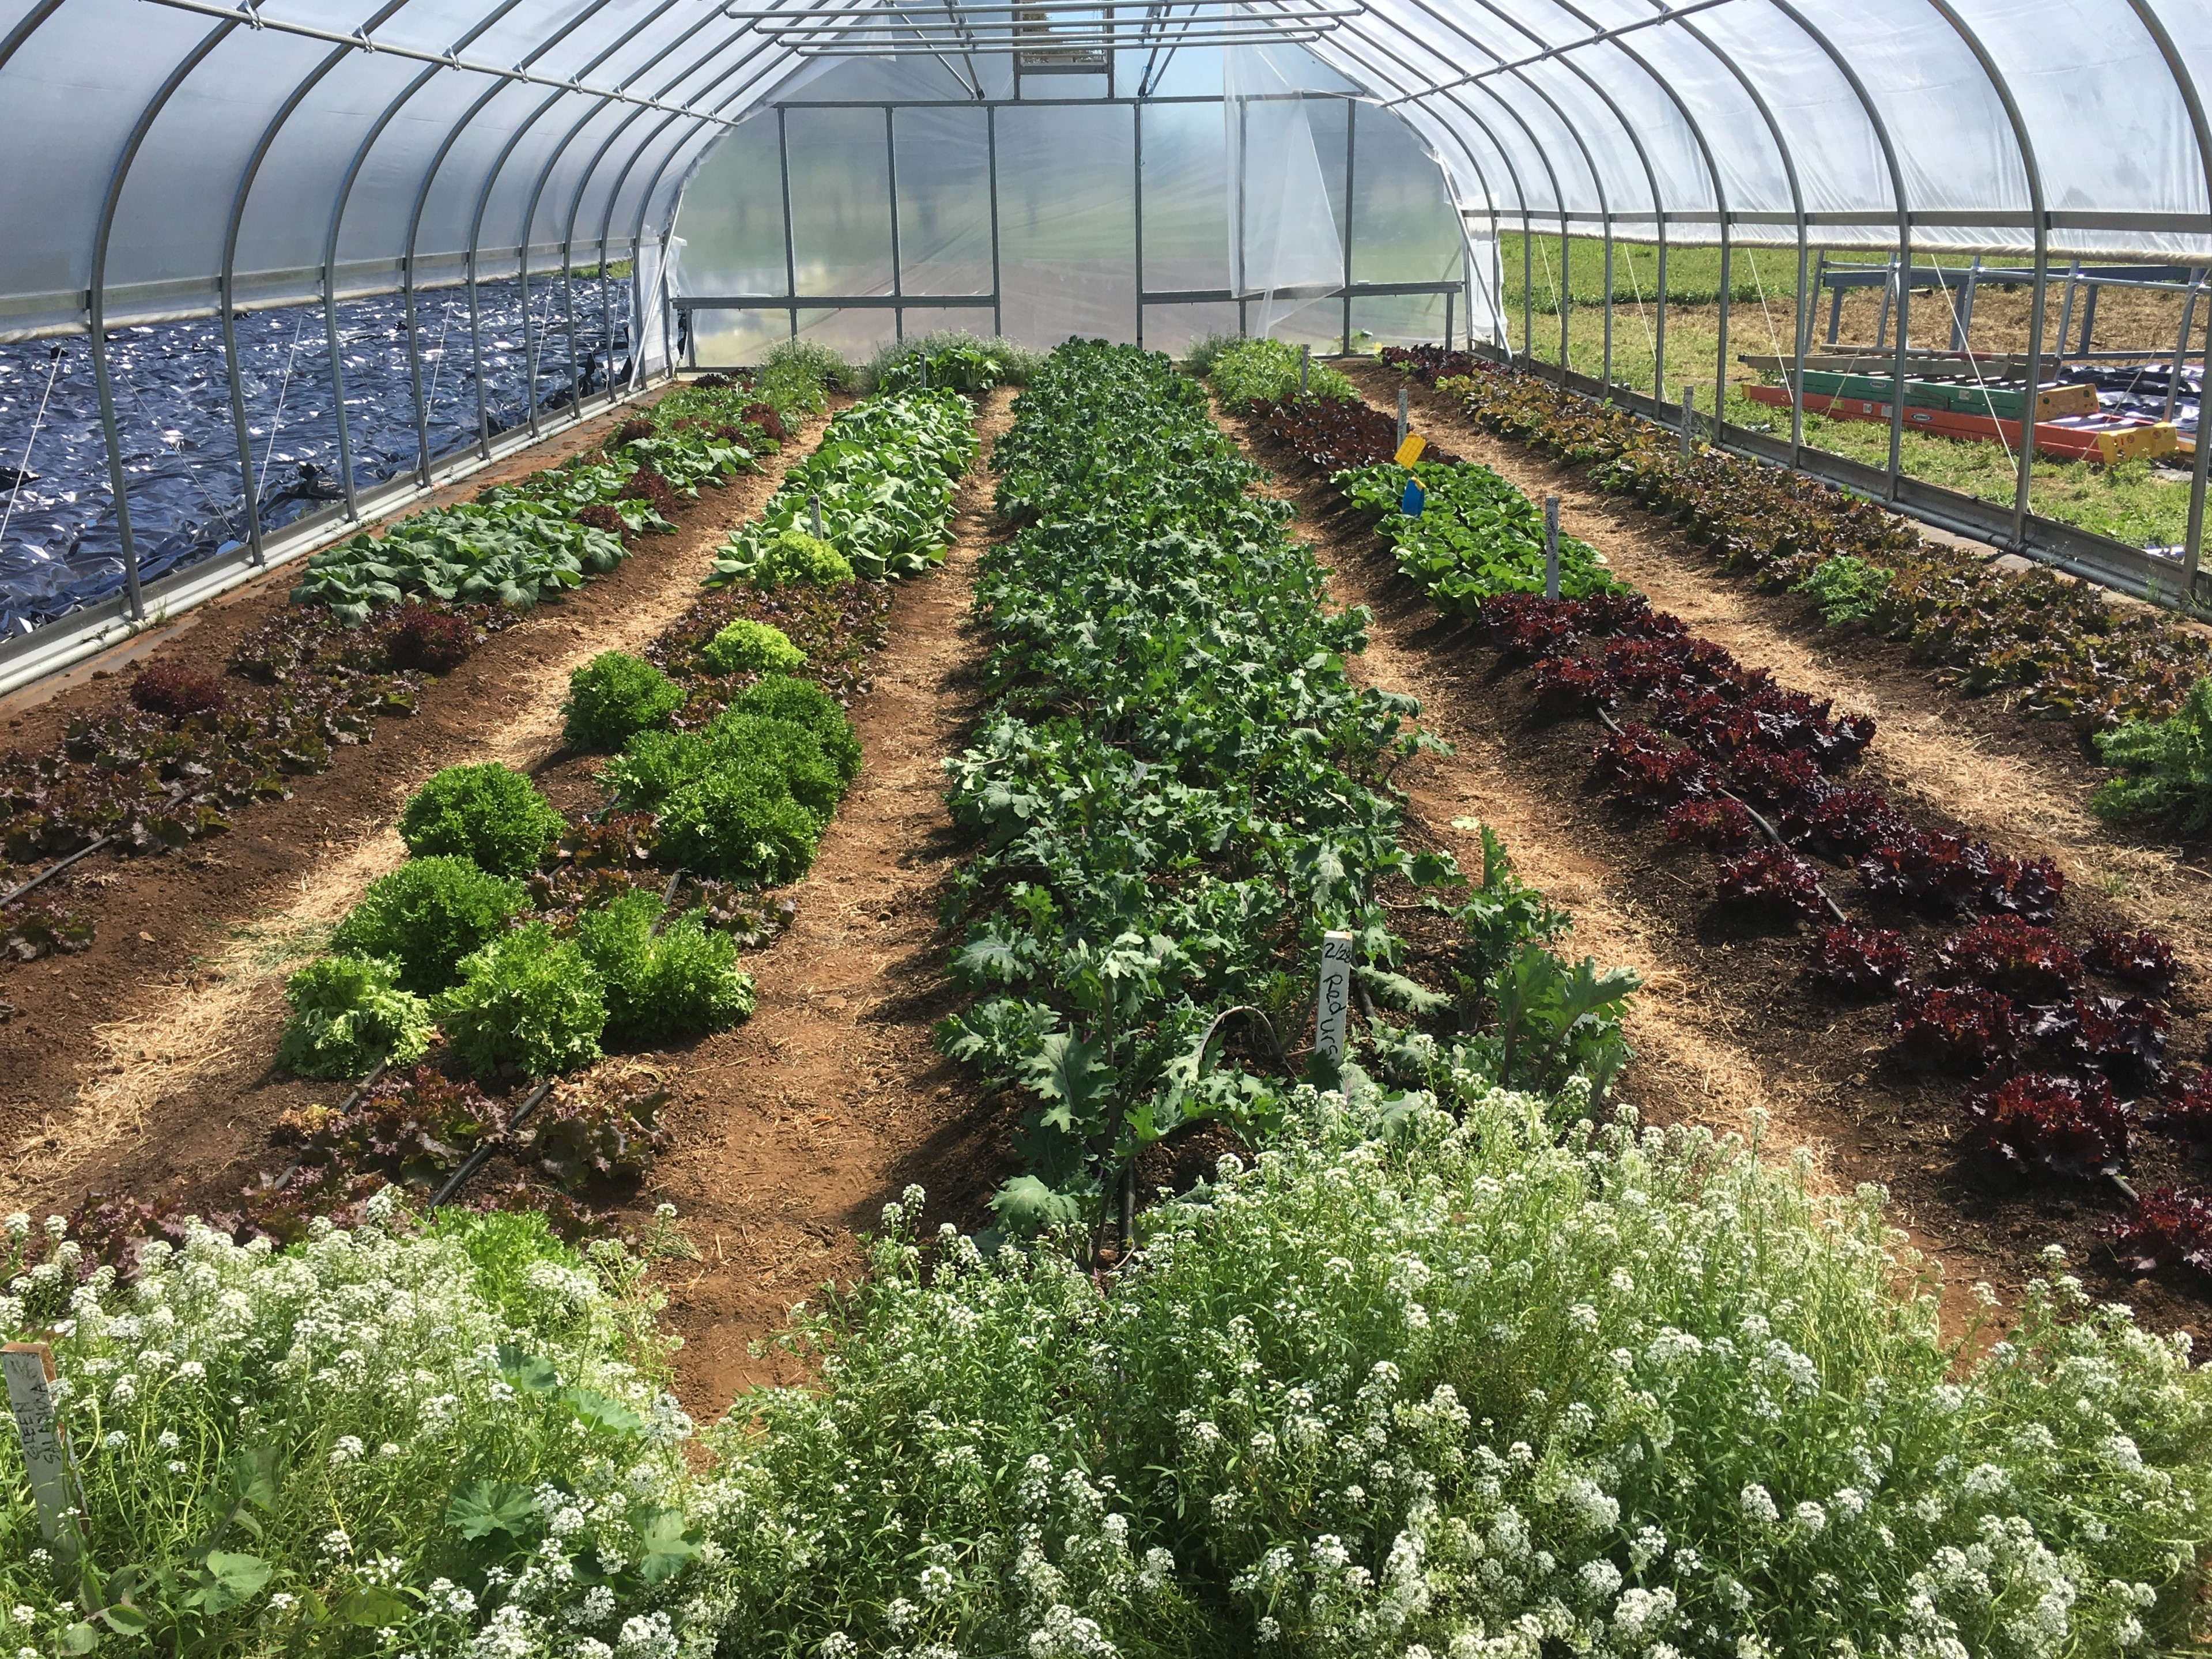
Objectives
Define key aspects of urban and small-scale agriculture, as well as soil health management in those systems
Compare different types of urban agriculture systems.
Identify the application of the NRCS soil health principles in urban and small-scale agriculture
Provide outline of this week’s training
Notes:
Go through list of objectives for the presentation

Slide 3
Urban and Small Farms
Do you have a significant number of small farms in your work area?
Do you work with urban customers?
How would you describe a “small farm” ?
Notes:
Ask participants for a show of hands related to the first two questions. Allow a few minutes for discussion of the third question.
Photo: Josh Beniston, NRCS

Slide 4
Small Farms Defined
One USDA definition is “small-scale” farms gross less than $250,000 in annual revenue.
Many farms are much smaller than that figure.
Perceptions and descriptions of small-scale farms differ a lot depending on the location, community, etc.
Notes:
Start out by asking participants – “Does anyone know how USDA defines small farms??”
Go through bullets. Key points are that first bullet is one way, economic revenue” that USDA defines small farms.
Big key is final bullet – perception of small farms is different in different parts of country, among different customer groups, etc.
Also key that the economic definition is one of many. Many people feel that number is too high.

Slide 5
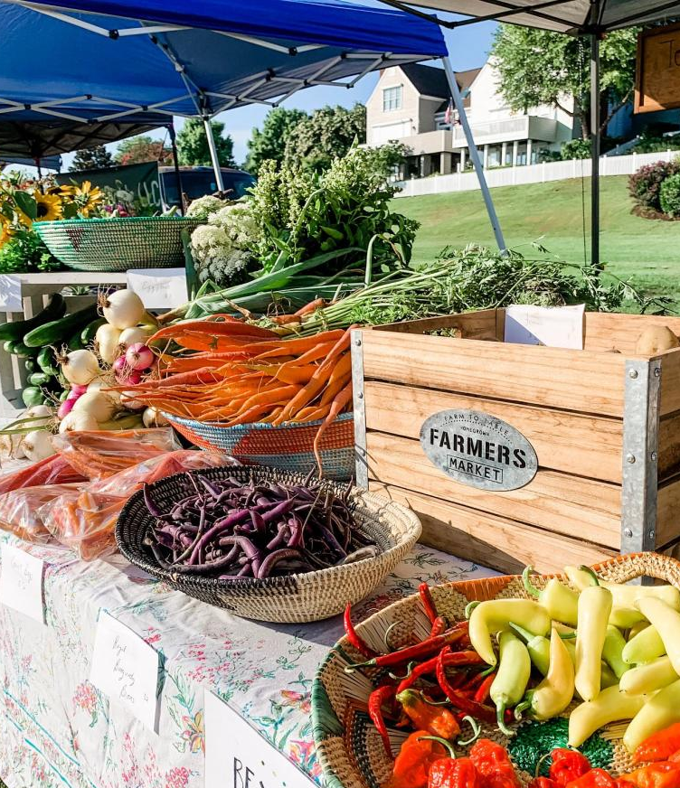
Small farms in U.S.
2022 Ag Census: small farms (1-9 acres) are the second largest farm-size category and account for approximately 250,000 farms.
Largest size category was 10-49 acres.
NRCS National Economist estimates 30 million U.S. households participate in gardening activities
Notes:
2022 Ag Census shows that small farms are very important to U.S. agriculture and make up a significant percentage of all farms in the country.
Farms 1-9 acres in size comprise 14% of the total farms in U.S., while farms 10-49 acres in size make up 20% of all farms.
In some parts of the country, farms that are 10-49 acres in size would be considered small farms.
https://www.nass.usda.gov/Publications/AgCensus/2022/index.php#full_report

Slide 6
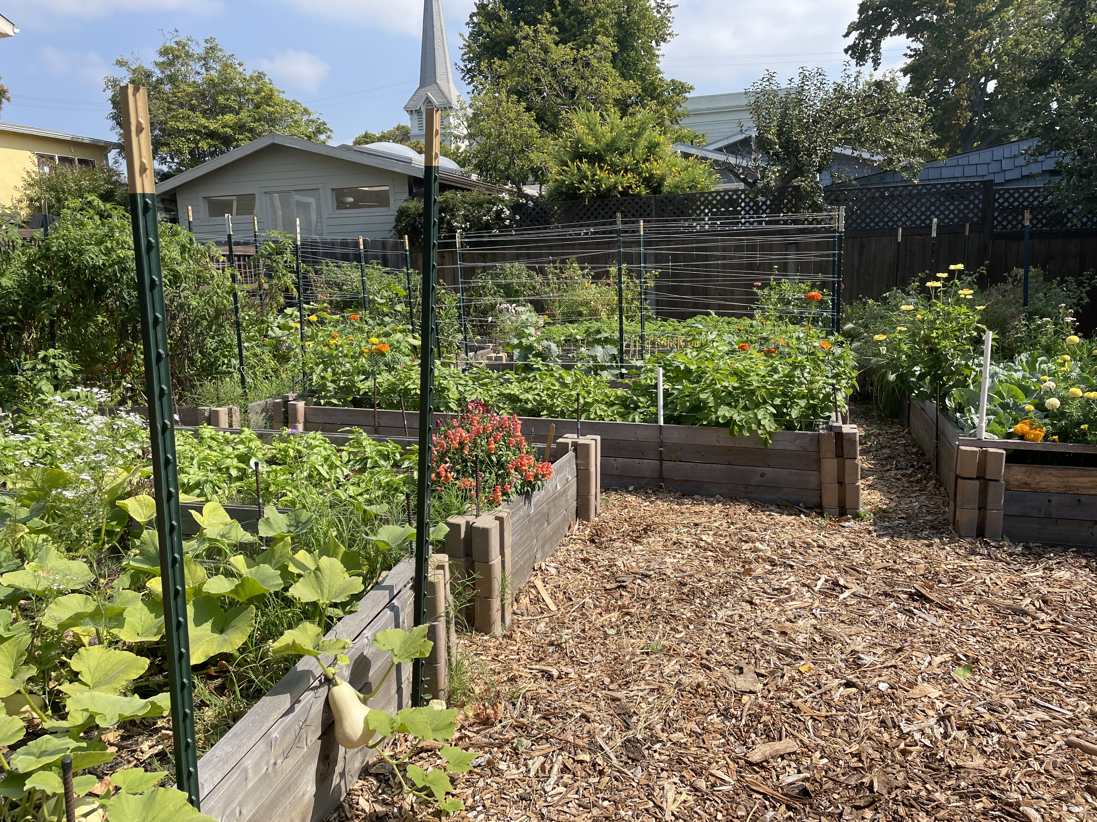
What is Urban Agriculture?
Gardens and farms in and around the places where large numbers of people live: cities, towns, neighborhoods, etc.
NRCS has not adopted an agency definition of urban agriculture.
  For flexibility and accessibility of “urban” focused programs.
“Urban” is a land use modifier.
Notes:
Go through bullets.
Second bullet has key. One good thing about NRCS not having a “formal definition” of urban agriculture is that it allows states flexibility in how they want to handle urban agriculture and urban areas in their programs. This also allows the agency to address the broad diversity in the way that urban agriculture may look across the country. Urban agriculture in South Dakota will likely look much different than in New York city, but NRCS has the flexibility to serve customers in both of those regions.
Photo: Josh Beniston, NRCS – urban farm in Berkeley CA

Slide 7
Types of Urban Agriculture
What are some different types urban agriculture settings and systems that you have encountered ?
Notes:
Ask this question to participants. This slide is a lead-in to the next few slides.
Key piece here is what kind of systems do we find in urban agriculture or what kinds of systems are considered to be urban agriculture ?

Slide 8
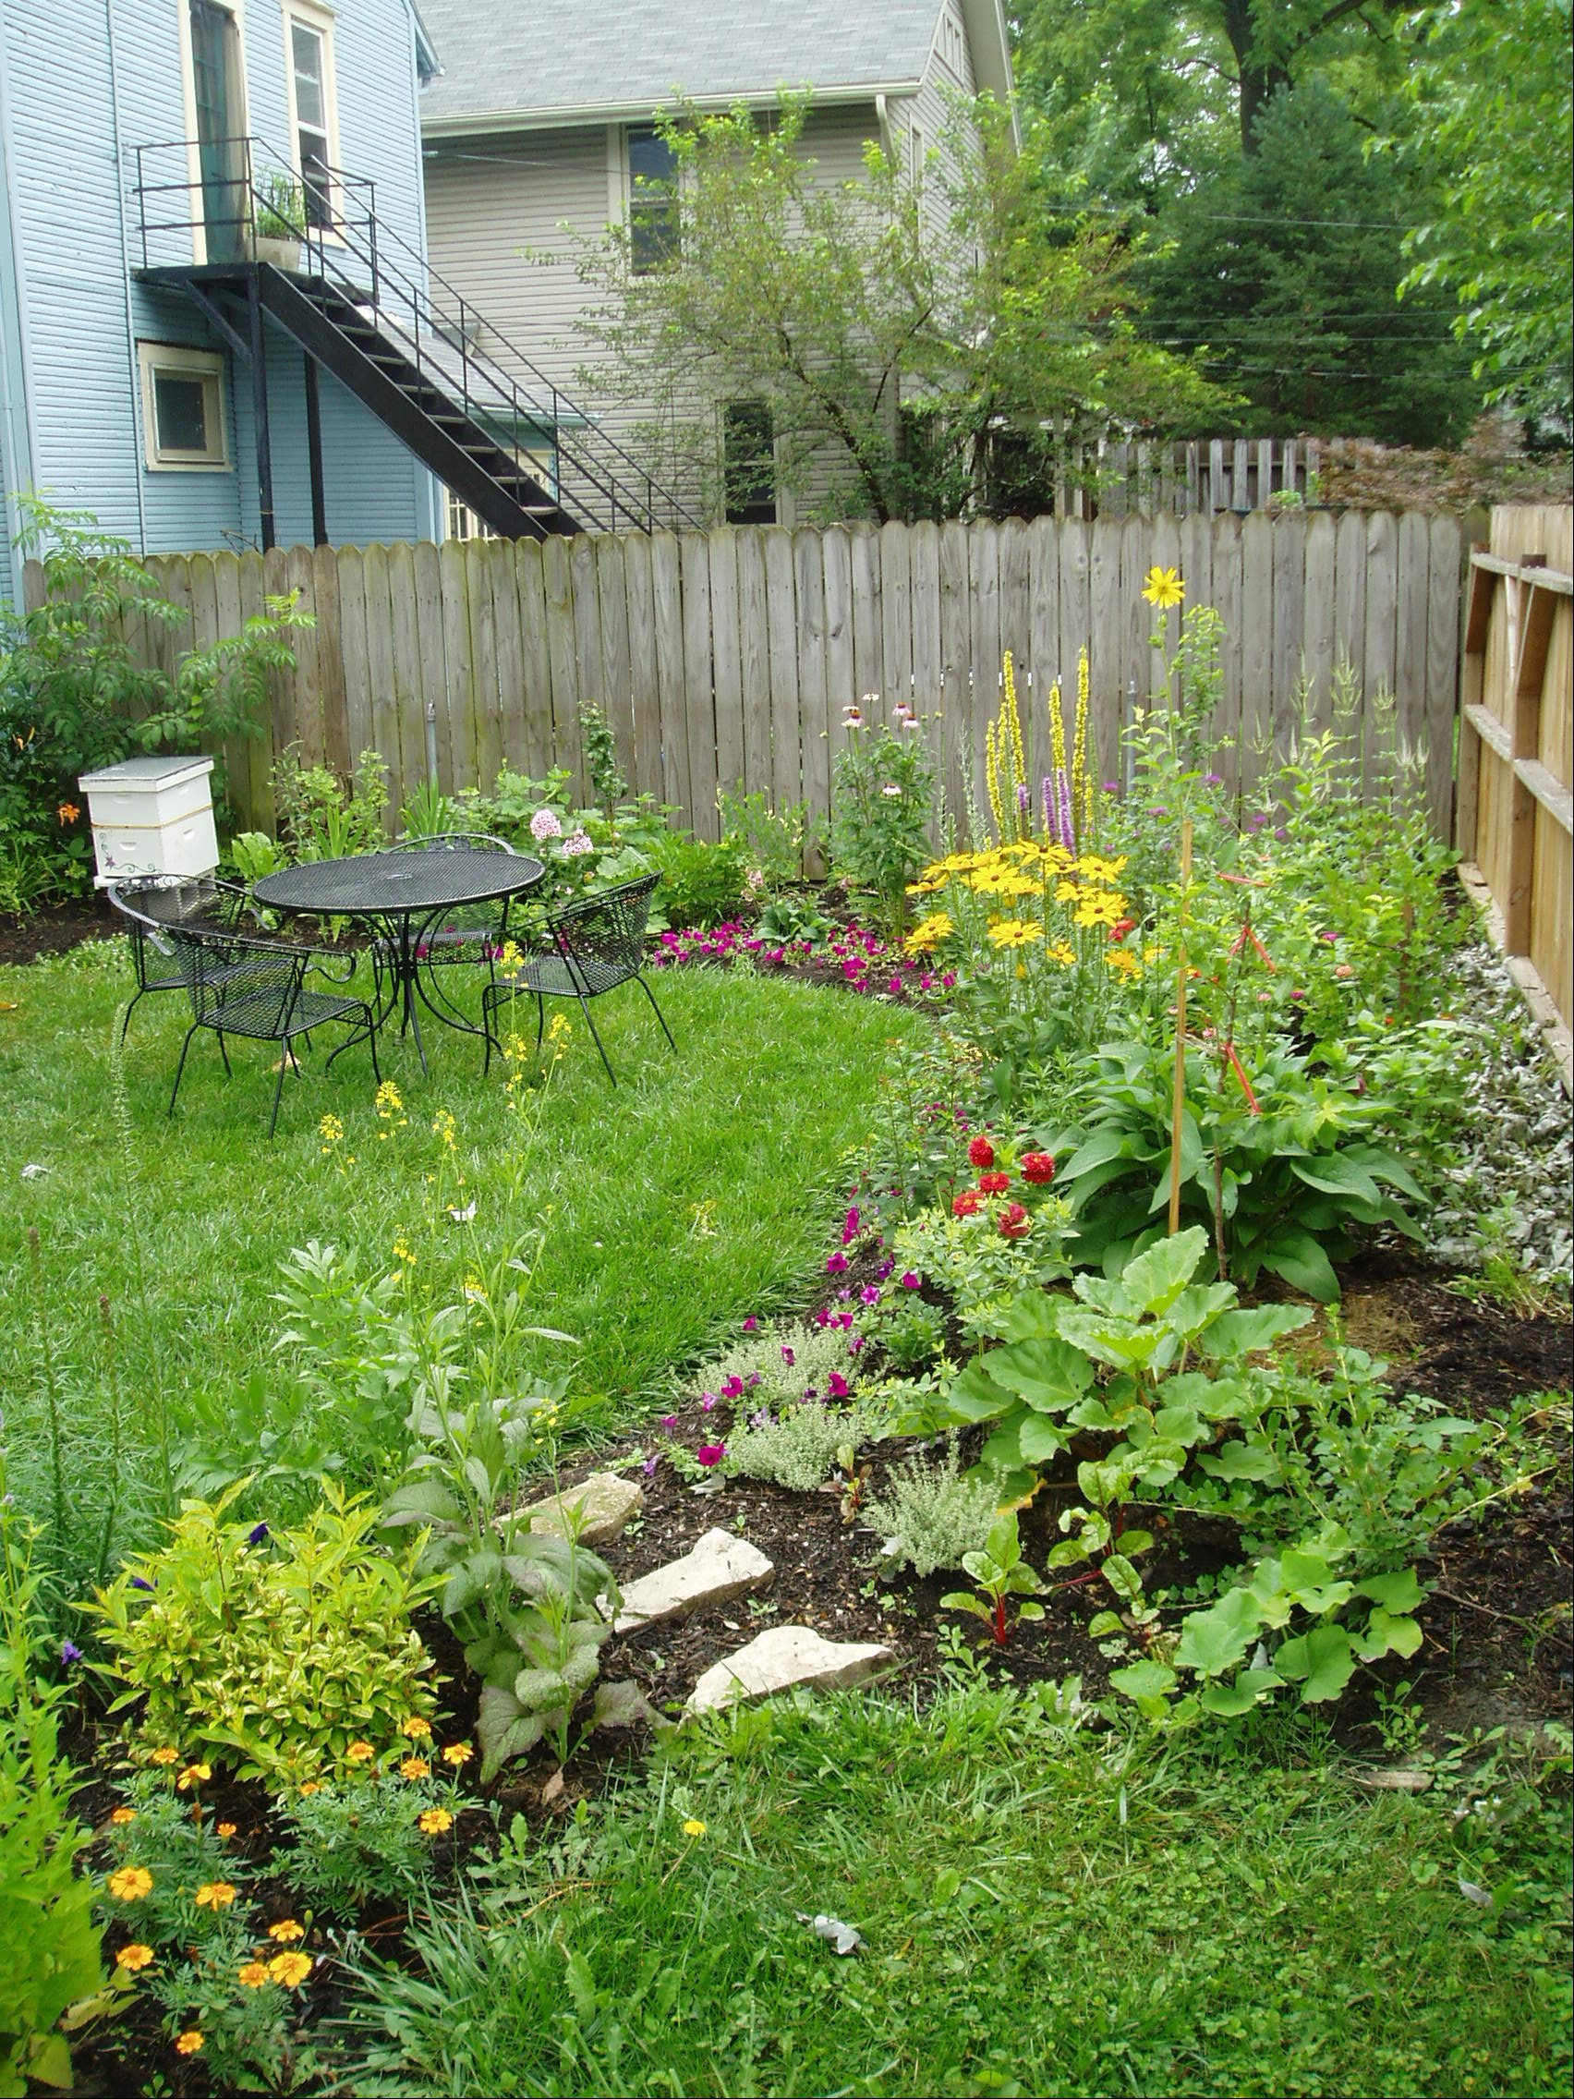
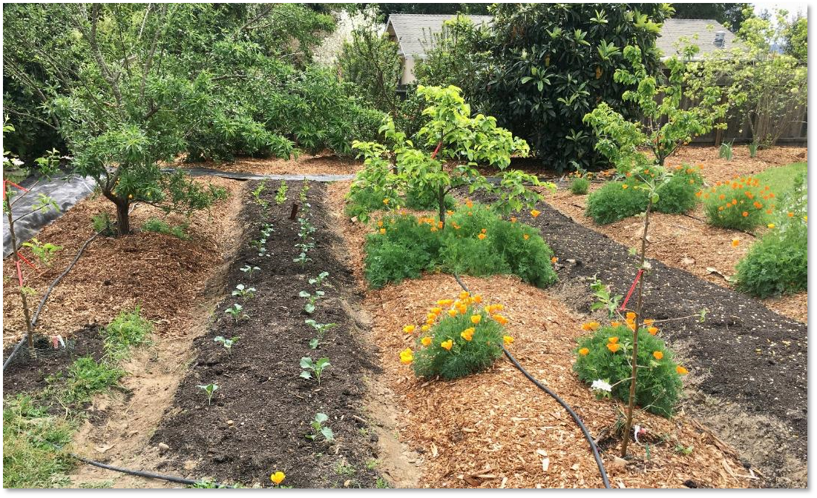
Backyard or Home Gardens
Notes:
Backyard or home gardens are one of the most common food production systems in the world and probably the most common type of urban agriculture. Home gardens can be very diverse, they can range in size from small kitchen gardens to large homestead gardens, and they are generally focused on producing vegetables, fruits, and herbs. Some home gardens may also contain livestock such as chickens. There are often many opportunities to enhance soil health, biodiversity, and resource conservation and home gardens
Photos: Josh Beniston, USDA NRCS. (Left) Backyard garden in Sonoma county, California with perennial plantings mulched in woodchips and annual crops mulched with compost. (Right) Backyard garden in a dense urban area of Columbus, Ohio.

Slide 9
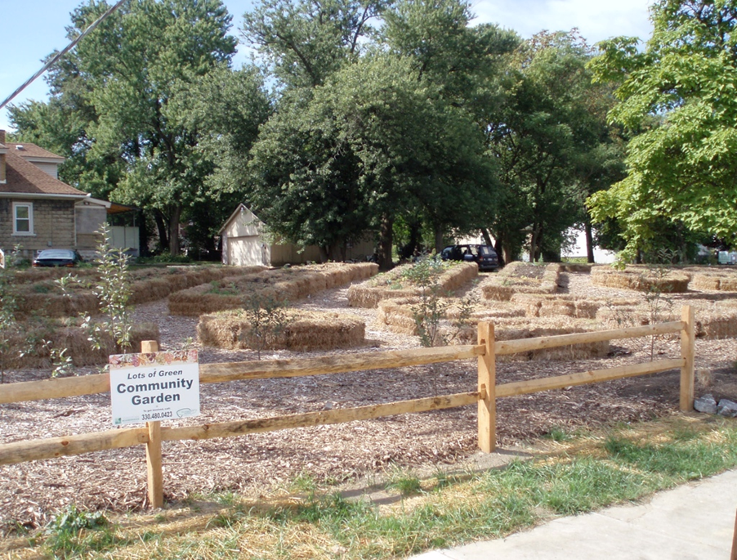
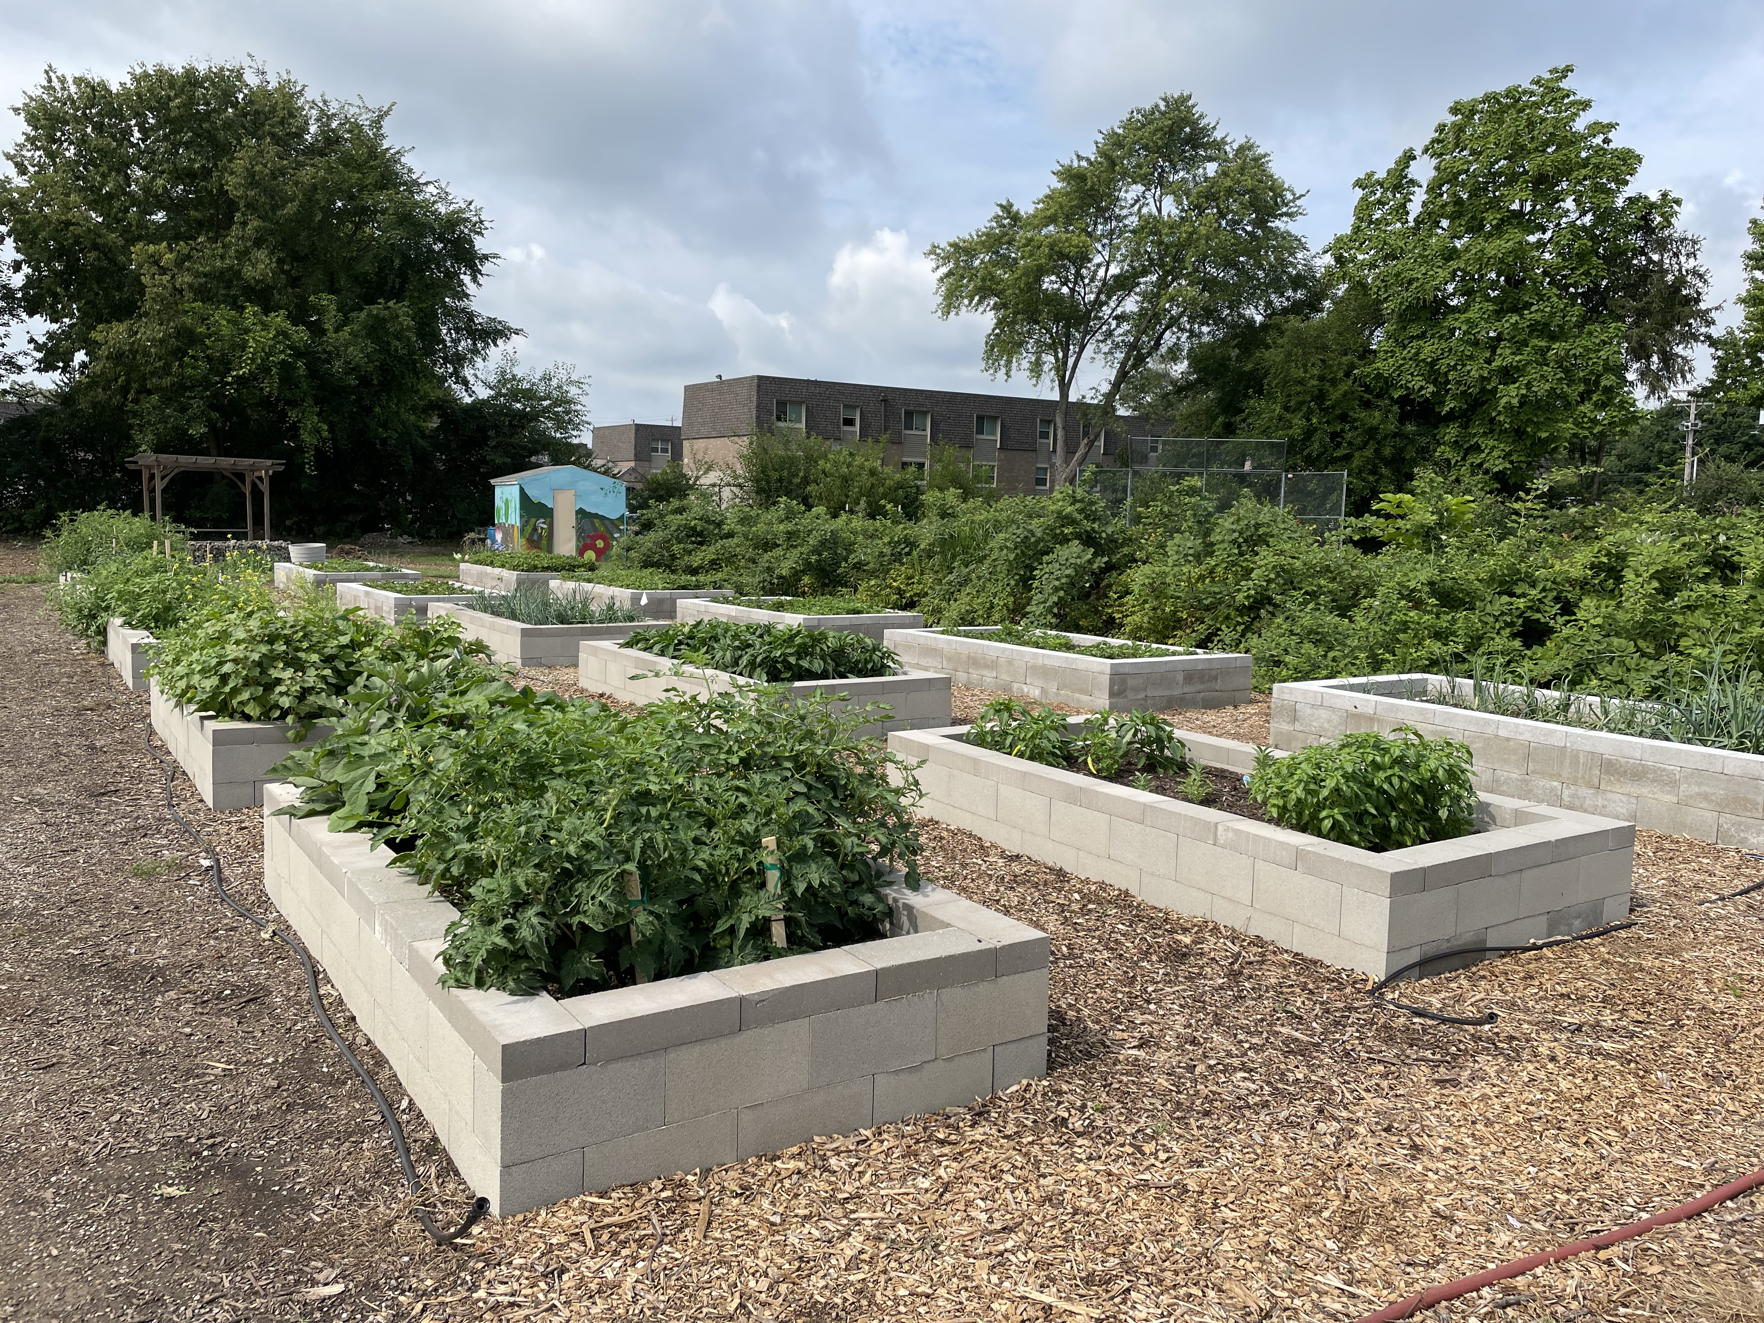
Community or Organizational Gardens
Notes:
Community and organizational gardens are another common type of urban agriculture. I think of community gardens as public spaces where local residents can essentially rent or utilize a plot for their home food production in the community garden. Community gardens are often found on land that is made available by a municipality or community organization.
Organizational gardens are urban agricultural sites that are located or and or operated with a community organization such as a school, church, hospital, or nonprofit organization. Both of these systems tend to be managed primarily by volunteers and the food produced in them is generally distributed for local consumption.
Photos: Josh Beniston, USDA NRCS. (Left) A community garden, operated by a non-profit organization, in a residential neighborhood in Youngstown, Ohio. (Right) Garden beds at a non-profit community farm in Hamilton, Ohio.

Slide 10
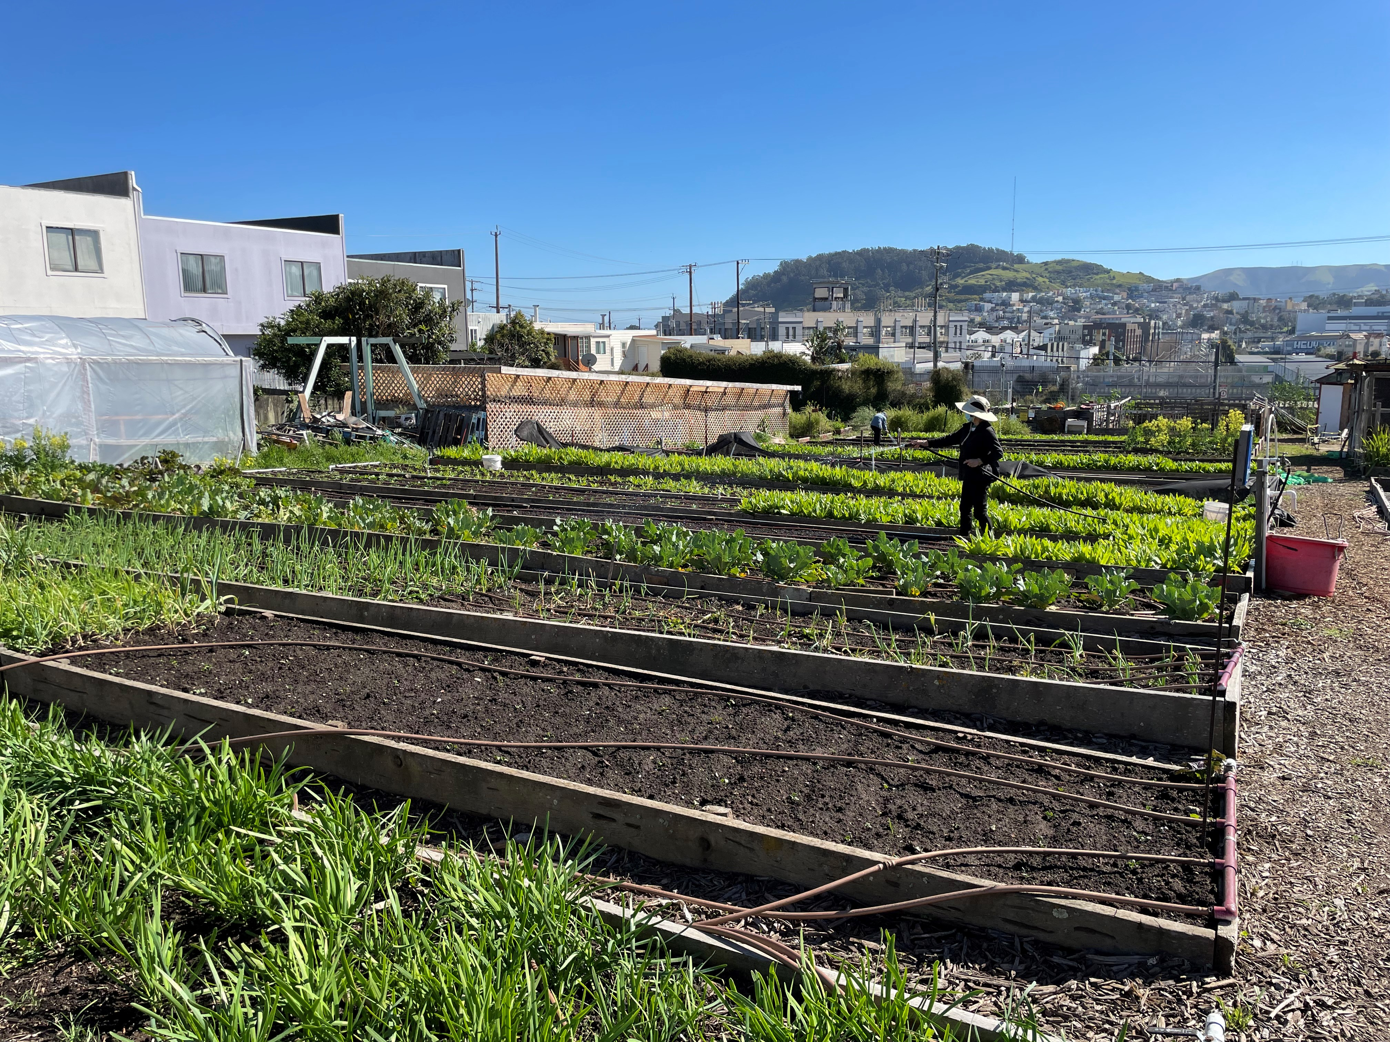
Urban Farms
Notes:
There are also small farms or market gardens in many urban areas. These are sites where producers our growing crops for sale. Urban farms generally utilize direct to consumer market outlets such as farmers markets, farm stands, and community supported agriculture (CSA). Many urban farms are outdoor production sites that utilized organic vegetable production techniques. There are also an increasing number of commercial urban farms that utilize indoor and controlled environment growing techniques.
Photo: Josh Beniston, USDA NRCS. An urban farm that specializes in Asian vegetables in San Francisco, California.

Slide 11
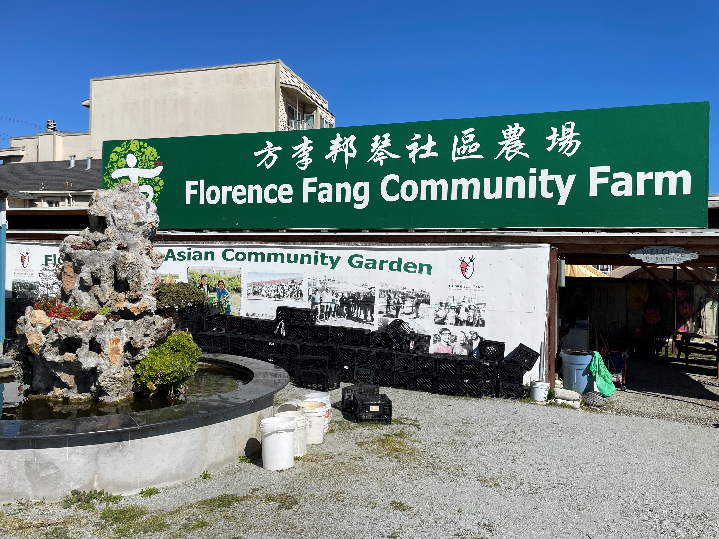
History of Urban Agriculture in U.S.
Recent immigrants growing foods from their home countries – well documented since at least 1800s
Victory gardens in World War 2 era
Social justice focus – approx. 1990s to present
Notes:
Urban agriculture has probably been around as long as we have had cities in the US. This slide puts together a few descriptions of urban agriculture in recent historical eras. One major theme for urban agriculture that is well documented since at least the 1800s and continues to this day, is that of recent immigrants to the US growing food from their home countries in the areas where they live. This allowed people to have access to crops and crop varieties that may have cultural significance and were not readily available in stores and markets. The victory garden era from World War 2 is an example of urban agriculture that many people have heard of. During the victory garden time many Americans began to participate in urban agriculture and in community gardens as a way to produce fresh fruits and vegetables for their homes and communities during the wartime. The most recent era of urban agriculture is described here as a social justice focus. So this again is characterized by people getting involved in urban agriculture to address issues in their community such as food access, food security, and access to vibrant green spaces. Ultimately there are many different reasons why people participate in urban agriculture, and these are just a few descriptions of motivations that have been widespread at different times.
Photo: Josh Beniston, USDA NRCS – San Francisco, CA

Slide 12
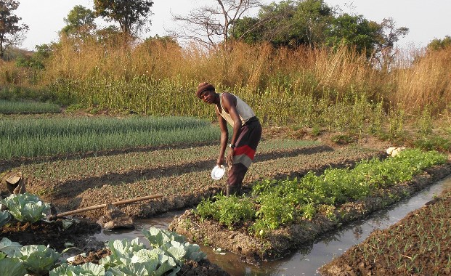
Global Perspective
From United Nations Food and Agriculture Organization (UNFAO)
5 of every 6 farms in the world consist of less than two acres,
operate only around 12 percent of all agricultural land,
and produce roughly 35 percent of the world's food.
Lowder, S. K., Sánchez, M. V., & Bertini, R. (2021). Which farms feed the world and has farmland become more concentrated?. World Development, 142, 105455.
Notes:
Is helpful to think about small farms from a global perspective. The information in this slide is taken from the United Nations Food and Agriculture Organization (UN FAO) and a study published in 2021. One incredible statistic on this topic is that five out of every six farms in the world are less than two acres in size. Really think about that number and what it means for a minute. One implication of this is that agriculture in our country is somewhat exceptional with larger farms. These small farms operate on only 12% of all agricultural land and they produced roughly 35% of the world's food. So small farms are very important to food production and food security globally. Some other considerations that aren't given in this report are that the majority of these farms are operated by women and people of color. It's also important to say that these are mostly subsistence farms and that the farmers managing them likely aren't making very much income, they are producing food for their families and communities. We also should recognize that small scale subsistence farming can be a challenging life and many of these people are likely living in poverty. The key message however is that the vast majority of farms and people identifying as farmers in the world are working with less than two acres of land to produce food. Small farms are more the rule than the exception.
Article Link:
https://www.sciencedirect.com/science/article/pii/S0305750X2100067X?via%3Dihub
The largest 1% of farms in the world (those larger than 50 ha or 120 acres) operate more than 70% of the world's farmland
Vegetable production in the Congo / GlobalHort Image Library - Credit: Remi Nono-Womdim, FAO

Slide 13
Urban and Small-scale Clients
What are some ways that NRCS clients on urban and small farms may be different from clients on larger farms?
Notes:
Coming back to our work with small scale farms and NRCS, I'd like us all to think about and respond to the following question: what are some ways that an NRCS clients on urban and small farms may be different from clients on larger farms. What do you think?
Allow participants to provide a few responses and provide affirming feedback.

Slide 14
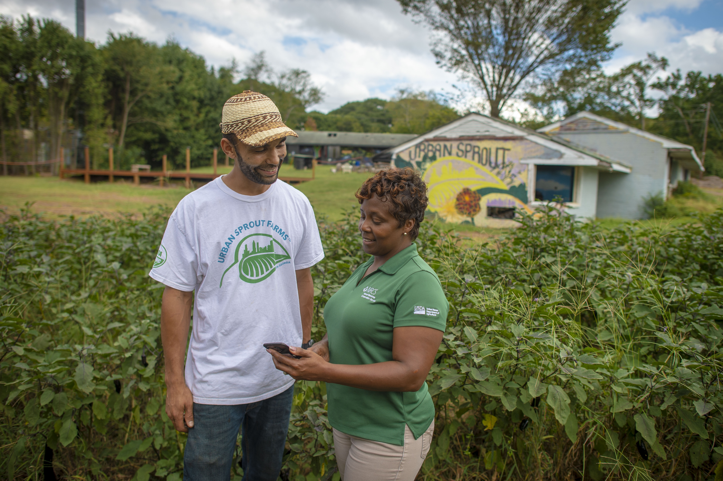
Urban and Small-scale Clients
Diverse cultural backgrounds.
New to farming and agriculture.
New to USDA programs
Land tenure
Notes:
A few of the key ways that clients on urban and small scale farms may be different from larger scale agriculture include the following. All of these points are true of both urban agriculture, as well as more rural small-scale farms. These clients may come from diverse cultural backgrounds. Similarly, producers on small scale farms may be new to farming and may be new to agriculture. They may not come from families who have a history of farming and may also be learning the skills of farming. These producers may be new to USDA programs. We sometimes take for granted that producers understand what NRCS is about and are familiar with our programs, and in these systems, we may need to do more explaining about what we do and about how our programs work. Finally, something that is often considered a challenge for urban and small scale agriculture is land tenure. Producers may not own the land that they farm and may be leasing it from either a private individual, or a public entity in the case of urban agriculture. So land tenure becomes an important issue both for the success of their operations as well As for how we approach working them with them on NRCS programs.
Coming back to soil health, insecure land tenure is often cited as a reason why some producers don't implement soil health management systems.
Photo: USDA flickr

Slide 15
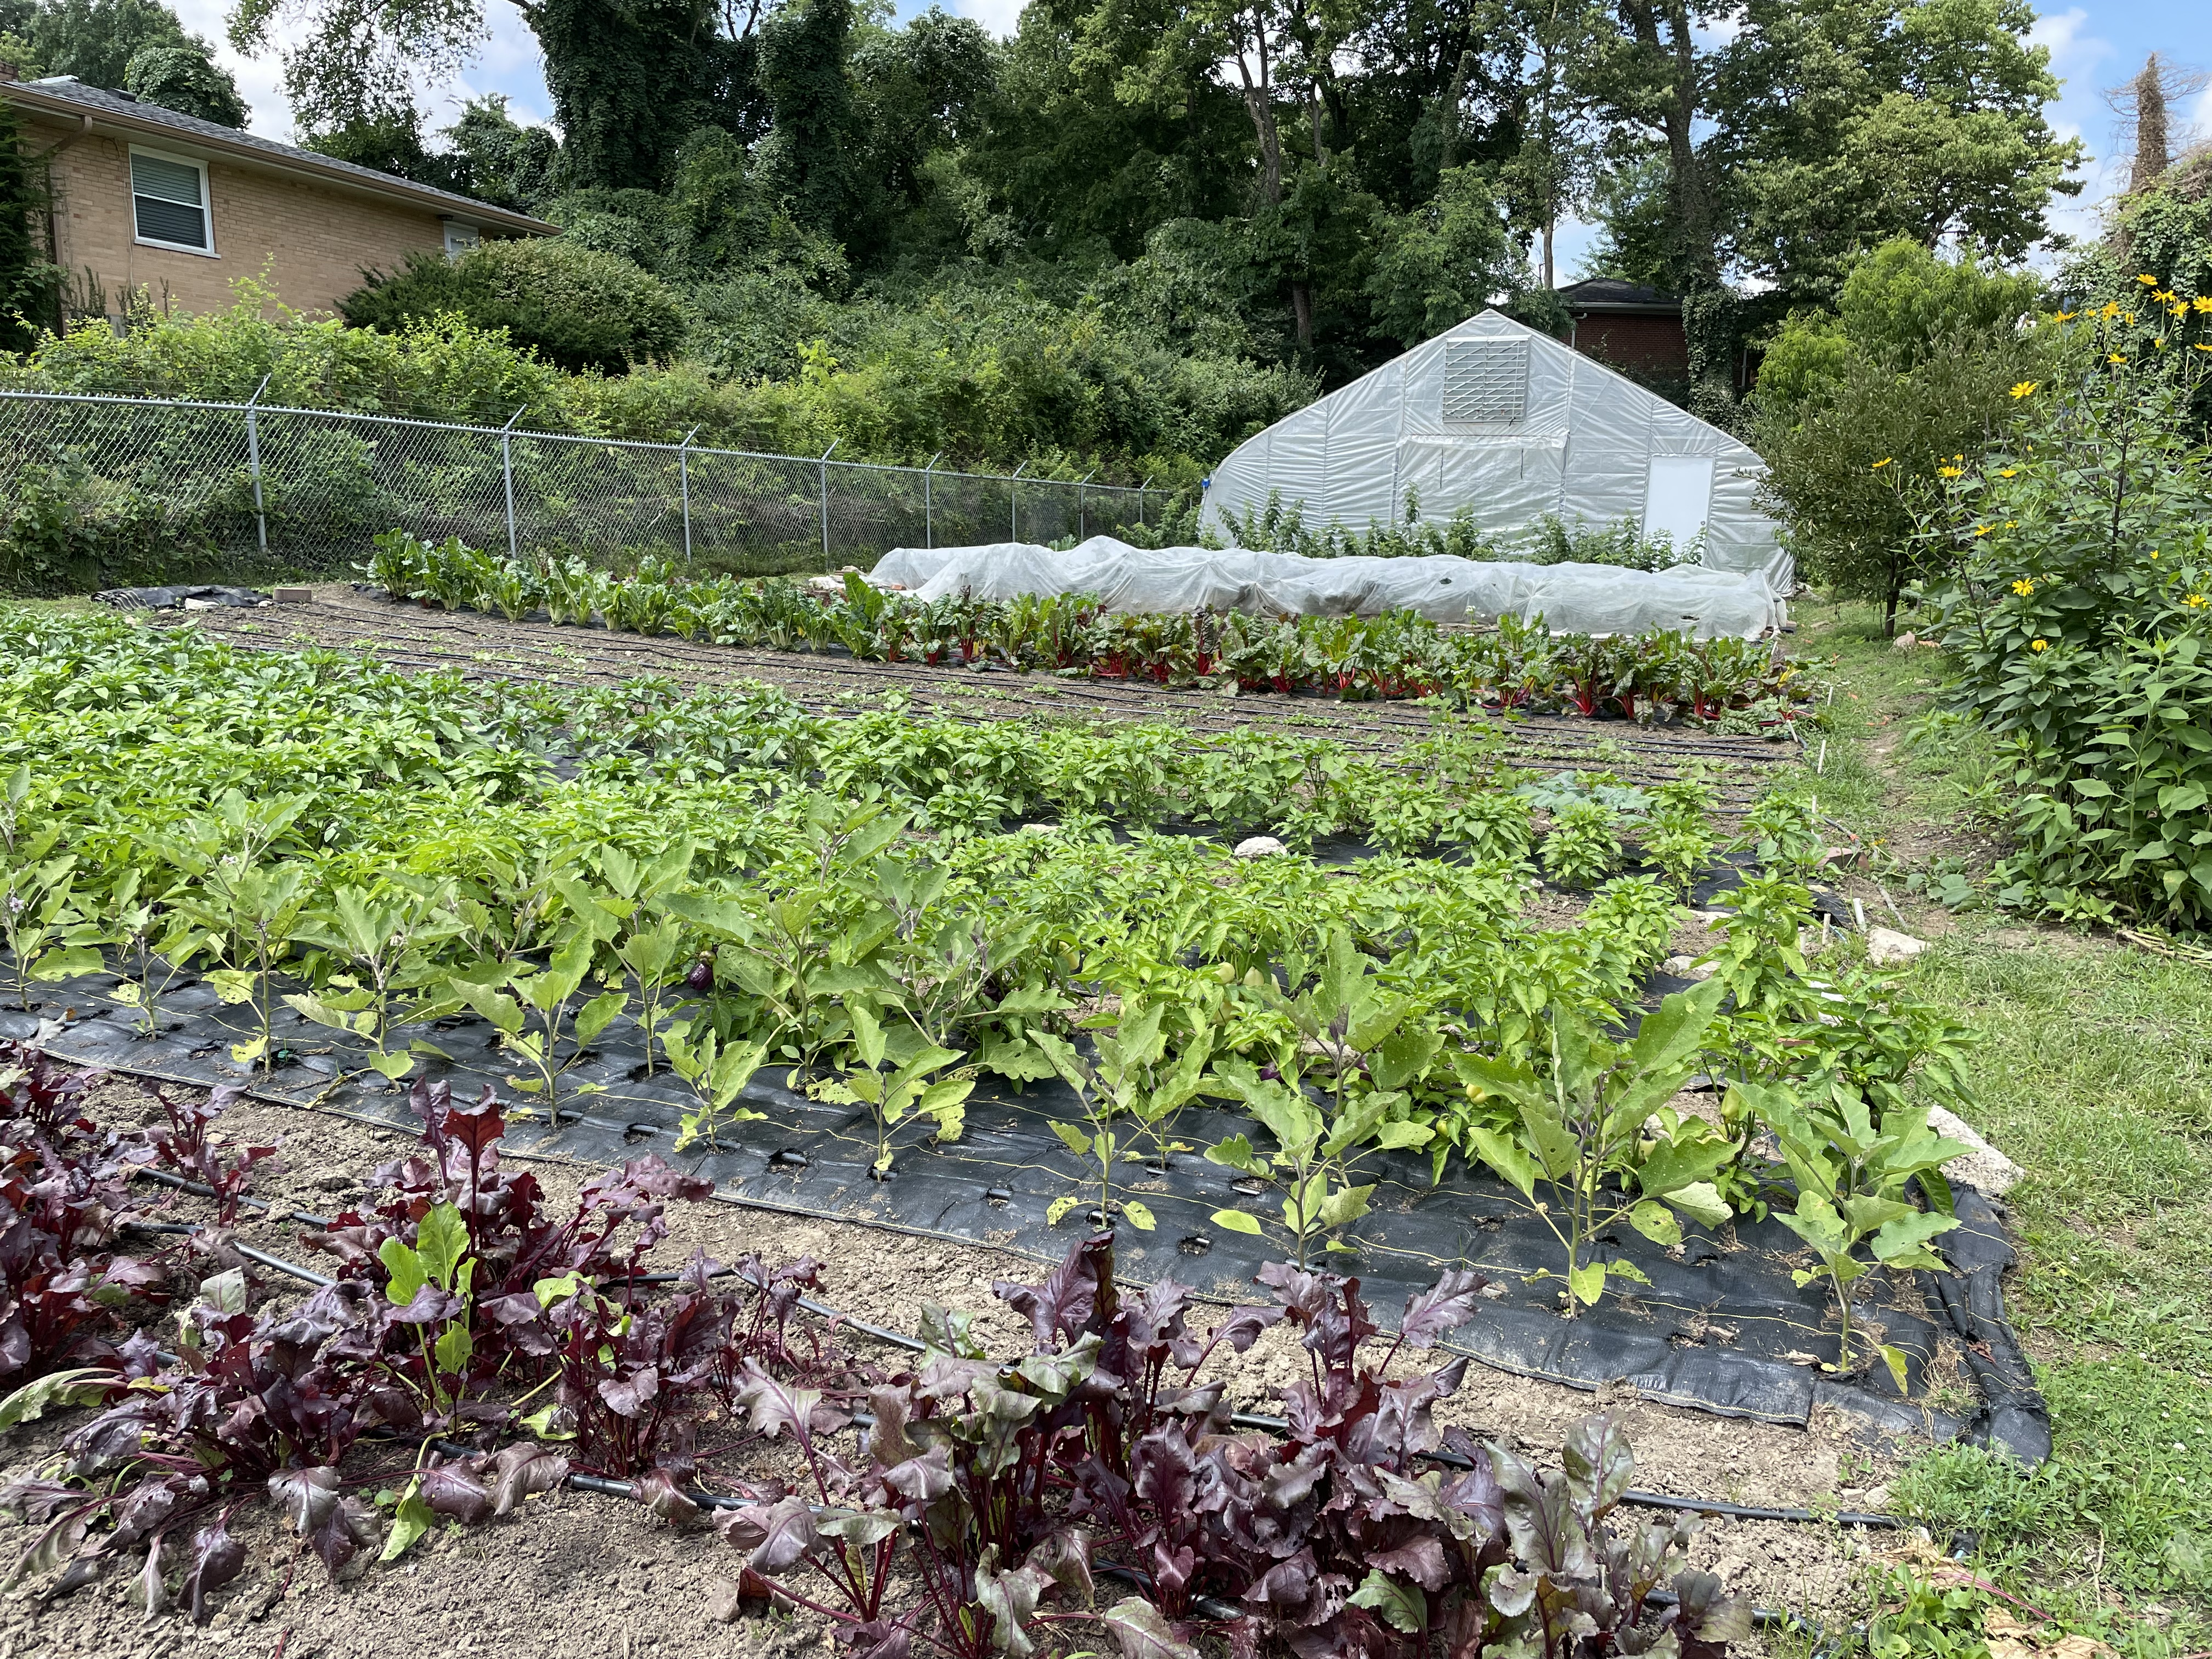
Misconceptions about urban and small-scale agriculture and NRCS Programs
The farm must produce at least $1,000 of agricultural products to be eligible.
Community and backyard gardens are not an eligible form of agricultural production.
Subsistence growers are not agricultural producers and subsistence lands are not eligible lands.
See “EQIP Mythbusters”
Notes:
There are some very widespread misconceptions about urban and small agriculture and NRCS programs. I would recommend that everyone here read through the EQIP mythbusters document. I have taken the information on this slide from that document and many longstanding NRCS colleagues have said that they feel that that should be required reading for NRCS employees.
The first major misconception is that a farm needs to produce at least $1000 of agricultural products to be eligible for our financial assistance programs. This is a very widespread idea in the agency that has been around a long time. My understanding from talking with others who have looked very closely at this issue is that our national policies do not actually have a far income requirement. The other two points on this slide are very similar in nature both to the first point and to each other. Subsistence growers are eligible for financial assistance programs. This includes community gardens and backyard gardens which many people might look at and say that is not a farm. Those activities are in fact a modern form of subsistence growing and, in many cases, may produce significant quantities of food for the residents and the community. The main take home point is simply that our national policies uh do not have anything stating that those types of production are not eligible for our programs.

Slide 16
Terminology
Food Security – When people have uninterrupted, unrestricted access to sufficient, safe, and nutritious food.
Food Sovereignty – Right of people to produce and control culturally appropriate foods.
First Foods – Foods that were part of indigenous culture prior to European contact
Notes:
These are some terms that are commonly used in discussions around equity and small-scale agriculture.
Go through terms on slide.
Assisting producers to improve their soil health and implement conservation on urban and small-scale farms has the potential to support all of these concepts.

Slide 17
Discussion
With a few neighbors, discuss the following:
What are the biggest opportunities for NRCS to support soil health in urban and small-scale agriculture?
What are the biggest challenges for NRCS to support soil health in urban and small-scale agriculture?
Notes:
Take approximately 5 minutes to discuss these questions with the group.
Participants should discuss these with a few other people that are seated around them and then be prepared to report back to the larger group.

Slide 18
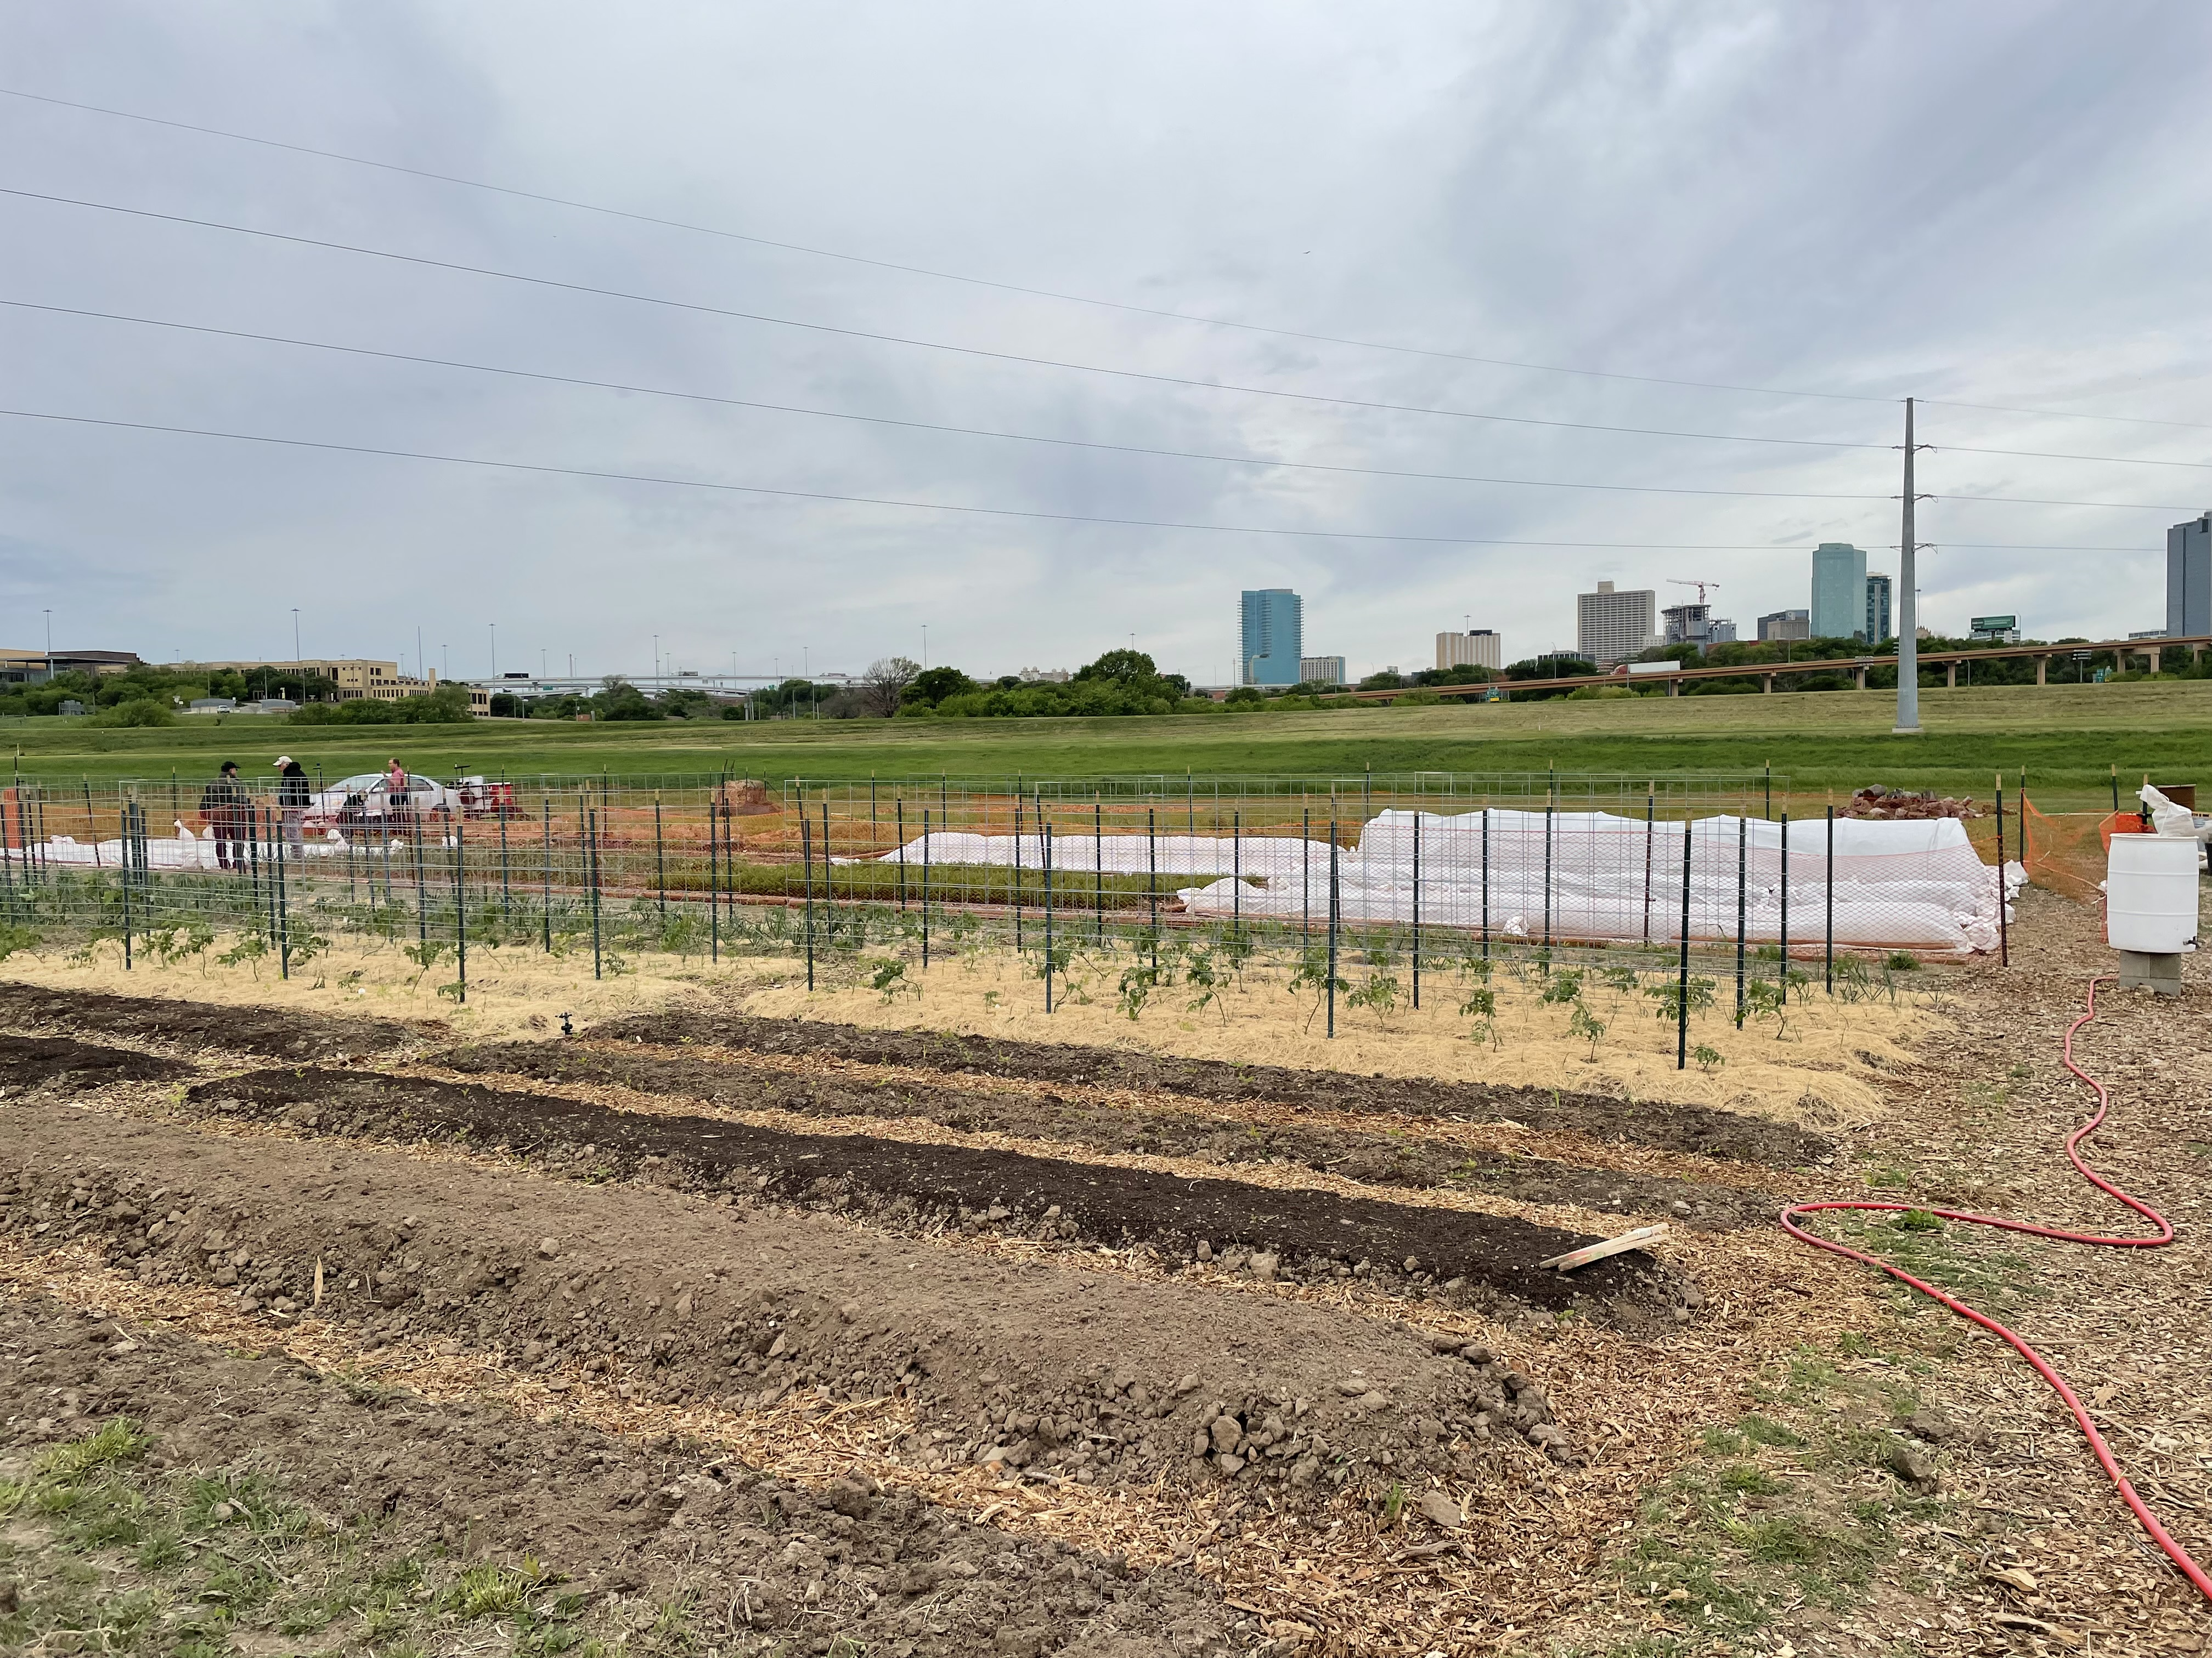
Soil Health for Urban and Small-Scale Agriculture
Notes:
Let’s look now at some basic ideas of applying our NRCS soil health concepts to small-scale and urban agriculture.
I like this photo from an urban market garden in Fort Worth TX because it shows the intensive nature of soil health management at small scales and it also demonstrates the use of multiple conservation practices including a few different kinds of mulch, each being used for a specific soil management purpose.
Photo: Josh Beniston, USDA NRCS

Slide 19
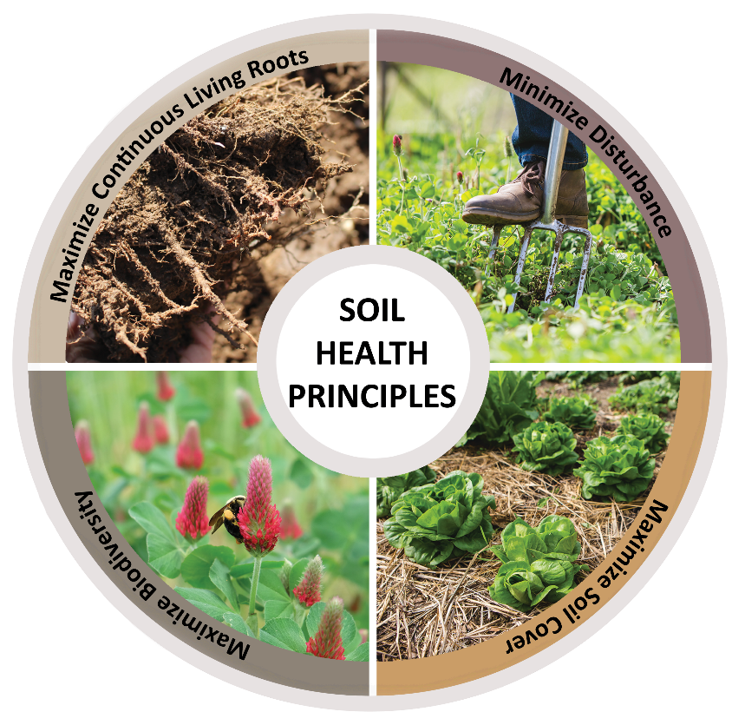
The Principles that Conserve the Soil Ecosystem
Minimize Disturbance
Maximize Cover
Maximize Biodiversity
Maximize Continuous Living Roots
Image: IN Urban Soil Health Program
Notes:
Does everyone remember our NRCS soil health principles, AKA the principles that conserve the soil ecosystem?? 😊
Go through the principles with the group.
What is important for us to note for this training, is that these principles scale down well. The majority of the practice says that we use to improve soil health at larger scales can also be practiced in urban and small-scale agriculture, but the tools and techniques and sometimes knowledge are a little different than what's used at larger scale. The image here Indiana NRCS and provides a visual evidence of soil health principles with small scale practices.

Slide 20
Soil Health Management Systems
What are some “common” soil health management system types for urban and small-scale agriculture?
Notes:
Ask the group to name some common soil management systems that they encounter on small scale and urban farms.
Look at the slides that follow to get an idea of the kind of examples to steer them towards.

Slide 21
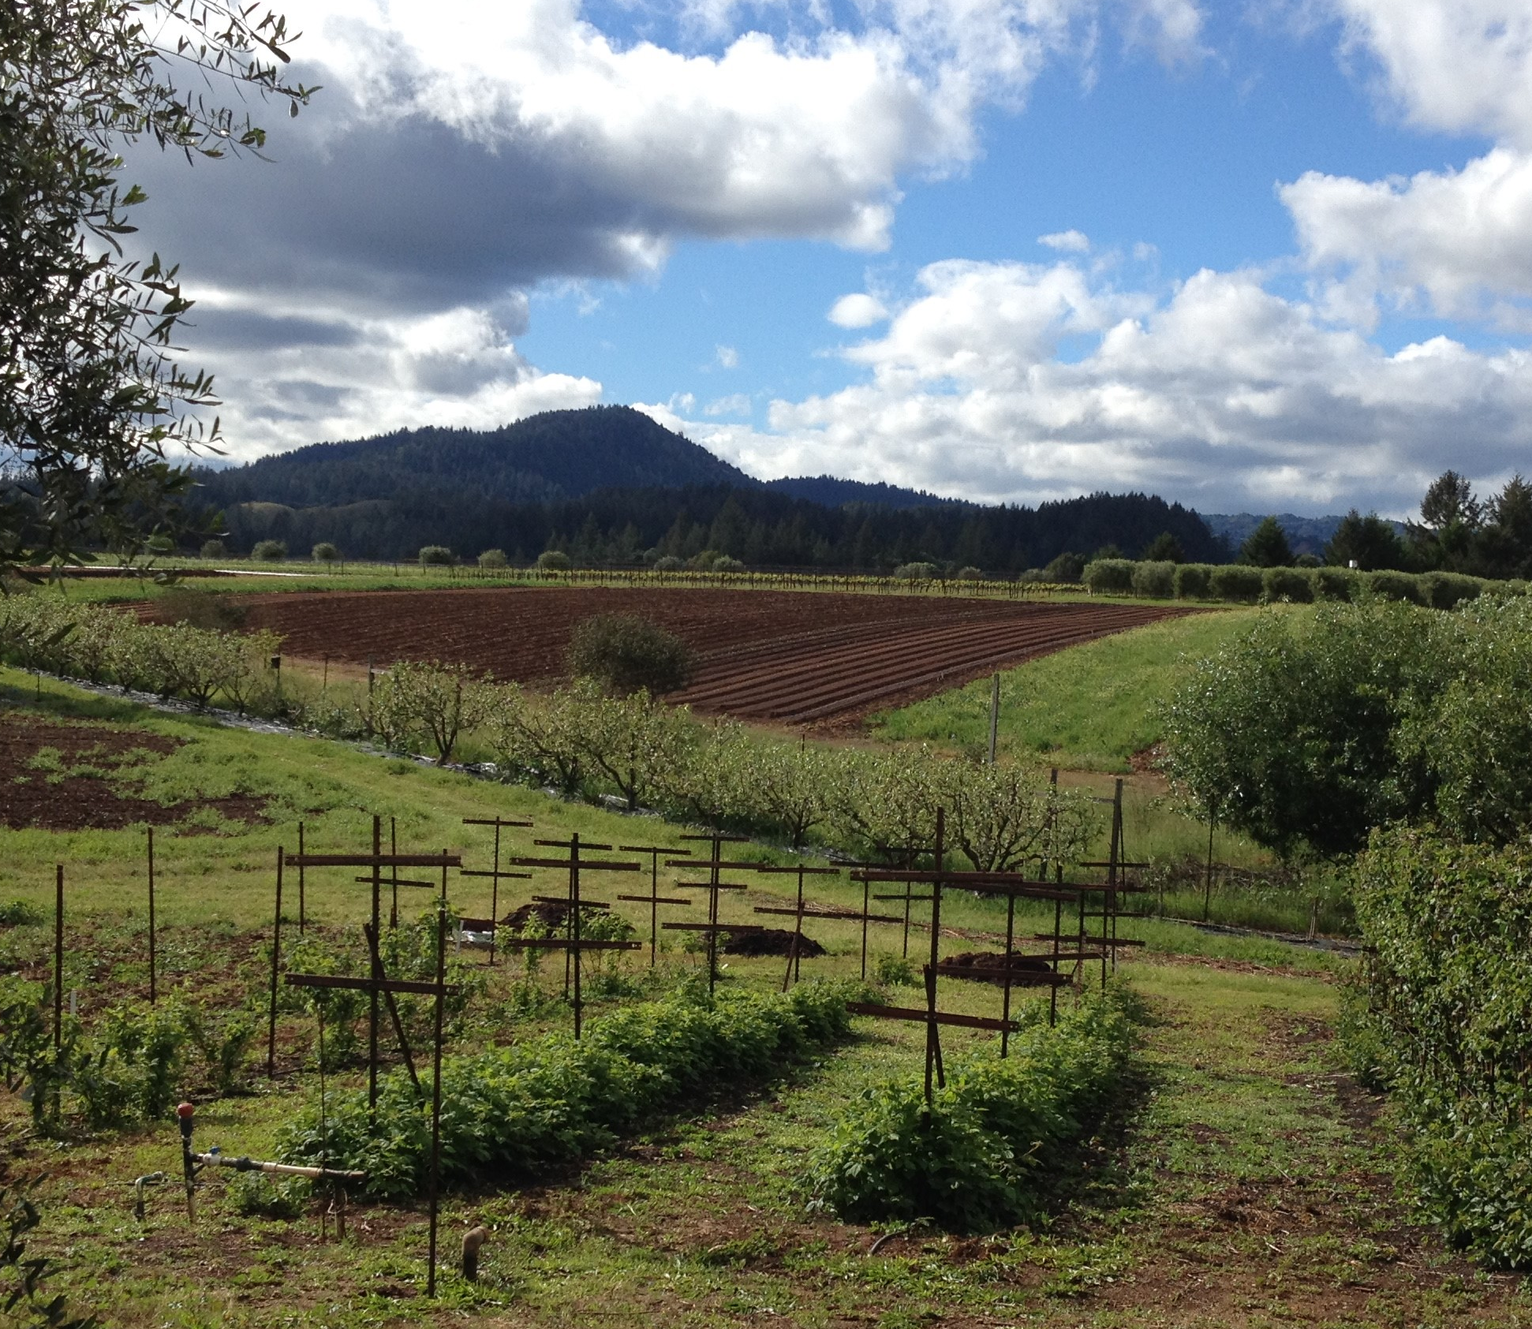
Organic Farms
Notes:
Many small farms, and urban farms, practice organic farming. A simple definition for organic farming is that it is done without the use of synthetic chemical inputs. As the photo demonstrates, organic vegetable farms generally use tillage both to prepare the soil and to manage weeds. In some soil health circles organic farming gets a bad rap for the use of tillage, however there is also a significant amount of evidence that organic farming can greatly improve soil health if practices such as the incorporation of organic matter and cover cropping are being used.
Photo: Josh Beniston, USDA NRCS

Slide 22
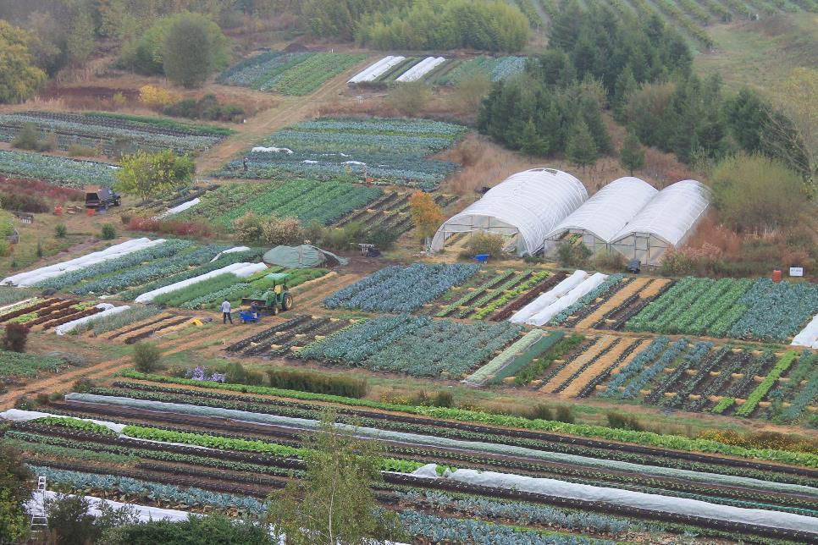
Intensive Market Gardens
Image: singingfrogsfarm.com
Notes:
Market gardens are intensive small-scale farms that produce vegetables and fruit for local consumption. They distribute their produce via direct to consumer marketing channels such as farmers markets, community supported agriculture (CSA), and farm stands. The term market garden has gained popularity with small scale producers in recent years, and it is common to find producers who identify as market gardeners in and around urban areas and on small farms.
The farm in the photo is Singing Frogs Farm in Sebastopol CA. Singing Frogs is well known in their region, as well as in the wider world of small scale farming, for developing a production system that is both highly productive and very regenerative to their soil health. They are known for their ability to produce large amounts of vegetables using no till methods. Their farm is approximately 3 acres in size, which is seen in the photograph. It's also notable that they maintain a year-round, living cover of vegetables and cover crops which also can be seen in this photograph, which was taking taken at some point during the cool season. Their three-acre farm produces enough income to support them in a high cost area and to employ a small farm team year round.
Photo: https://www.singingfrogsfarm.com/

Slide 23
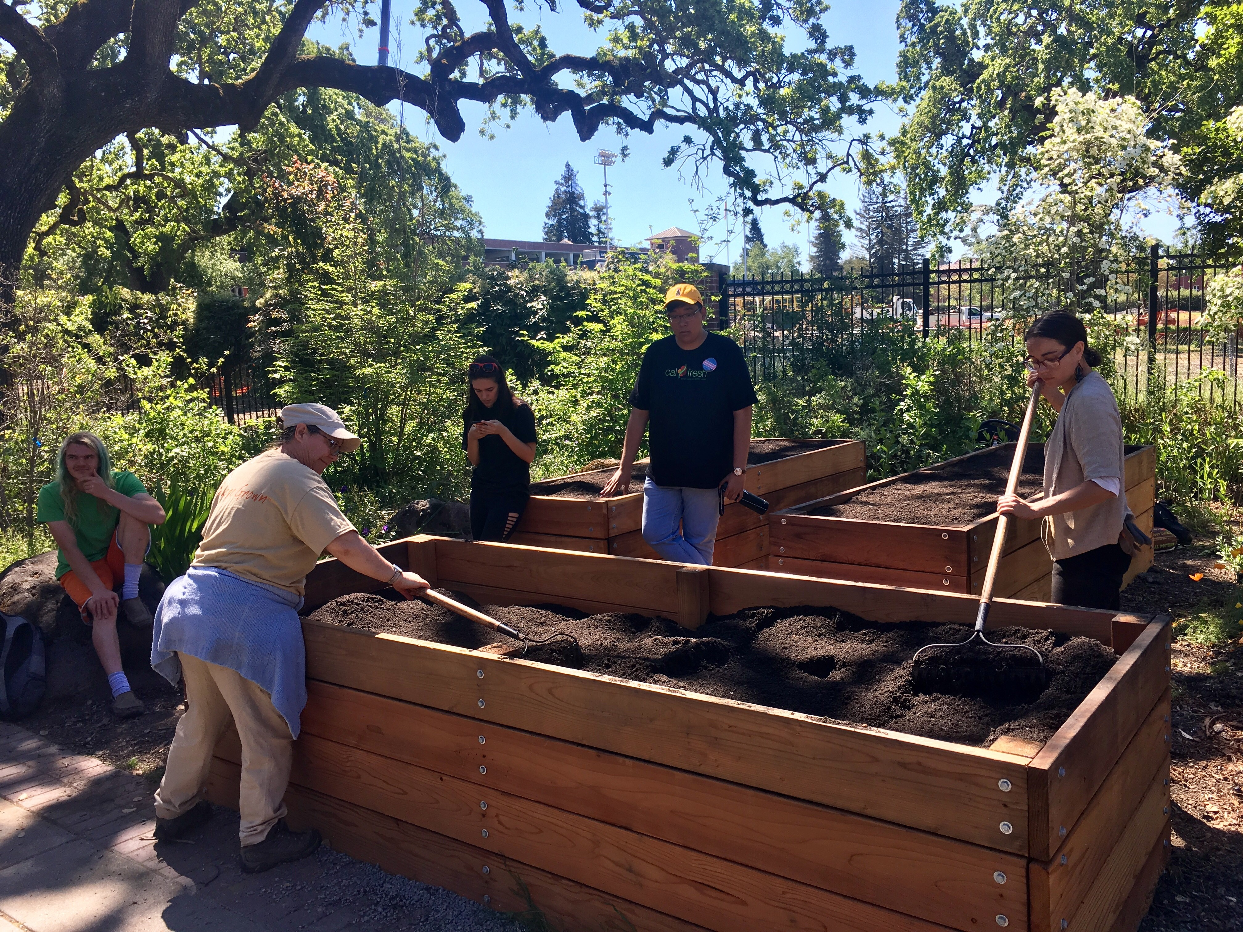
Raised Bed Gardens
Notes:
Constructed raised beds are a common soil health management system, particularly in urban areas. Raised beds such as the ones in the photograph are generally filled with what we would call soilless media. This material generally consists of a mixture of compost and potting soil materials, and in some cases the native soil. Raised beds are a good option at many urban sites where significant soil health resource concerns are a reality or a possibility. NRCS has an interim conservation practice that provides assistance for constructed raised beds, and we will discuss that practice more later in the training. Well managed raised beds can be a very productive system.
These are just a few common examples of the many different ways that soil health can be managed at small scales. We will discuss small scale soil health management in much greater detail in the remaining modules of the training.
Photo: Josh Beniston, USDA NRCS

Slide 24
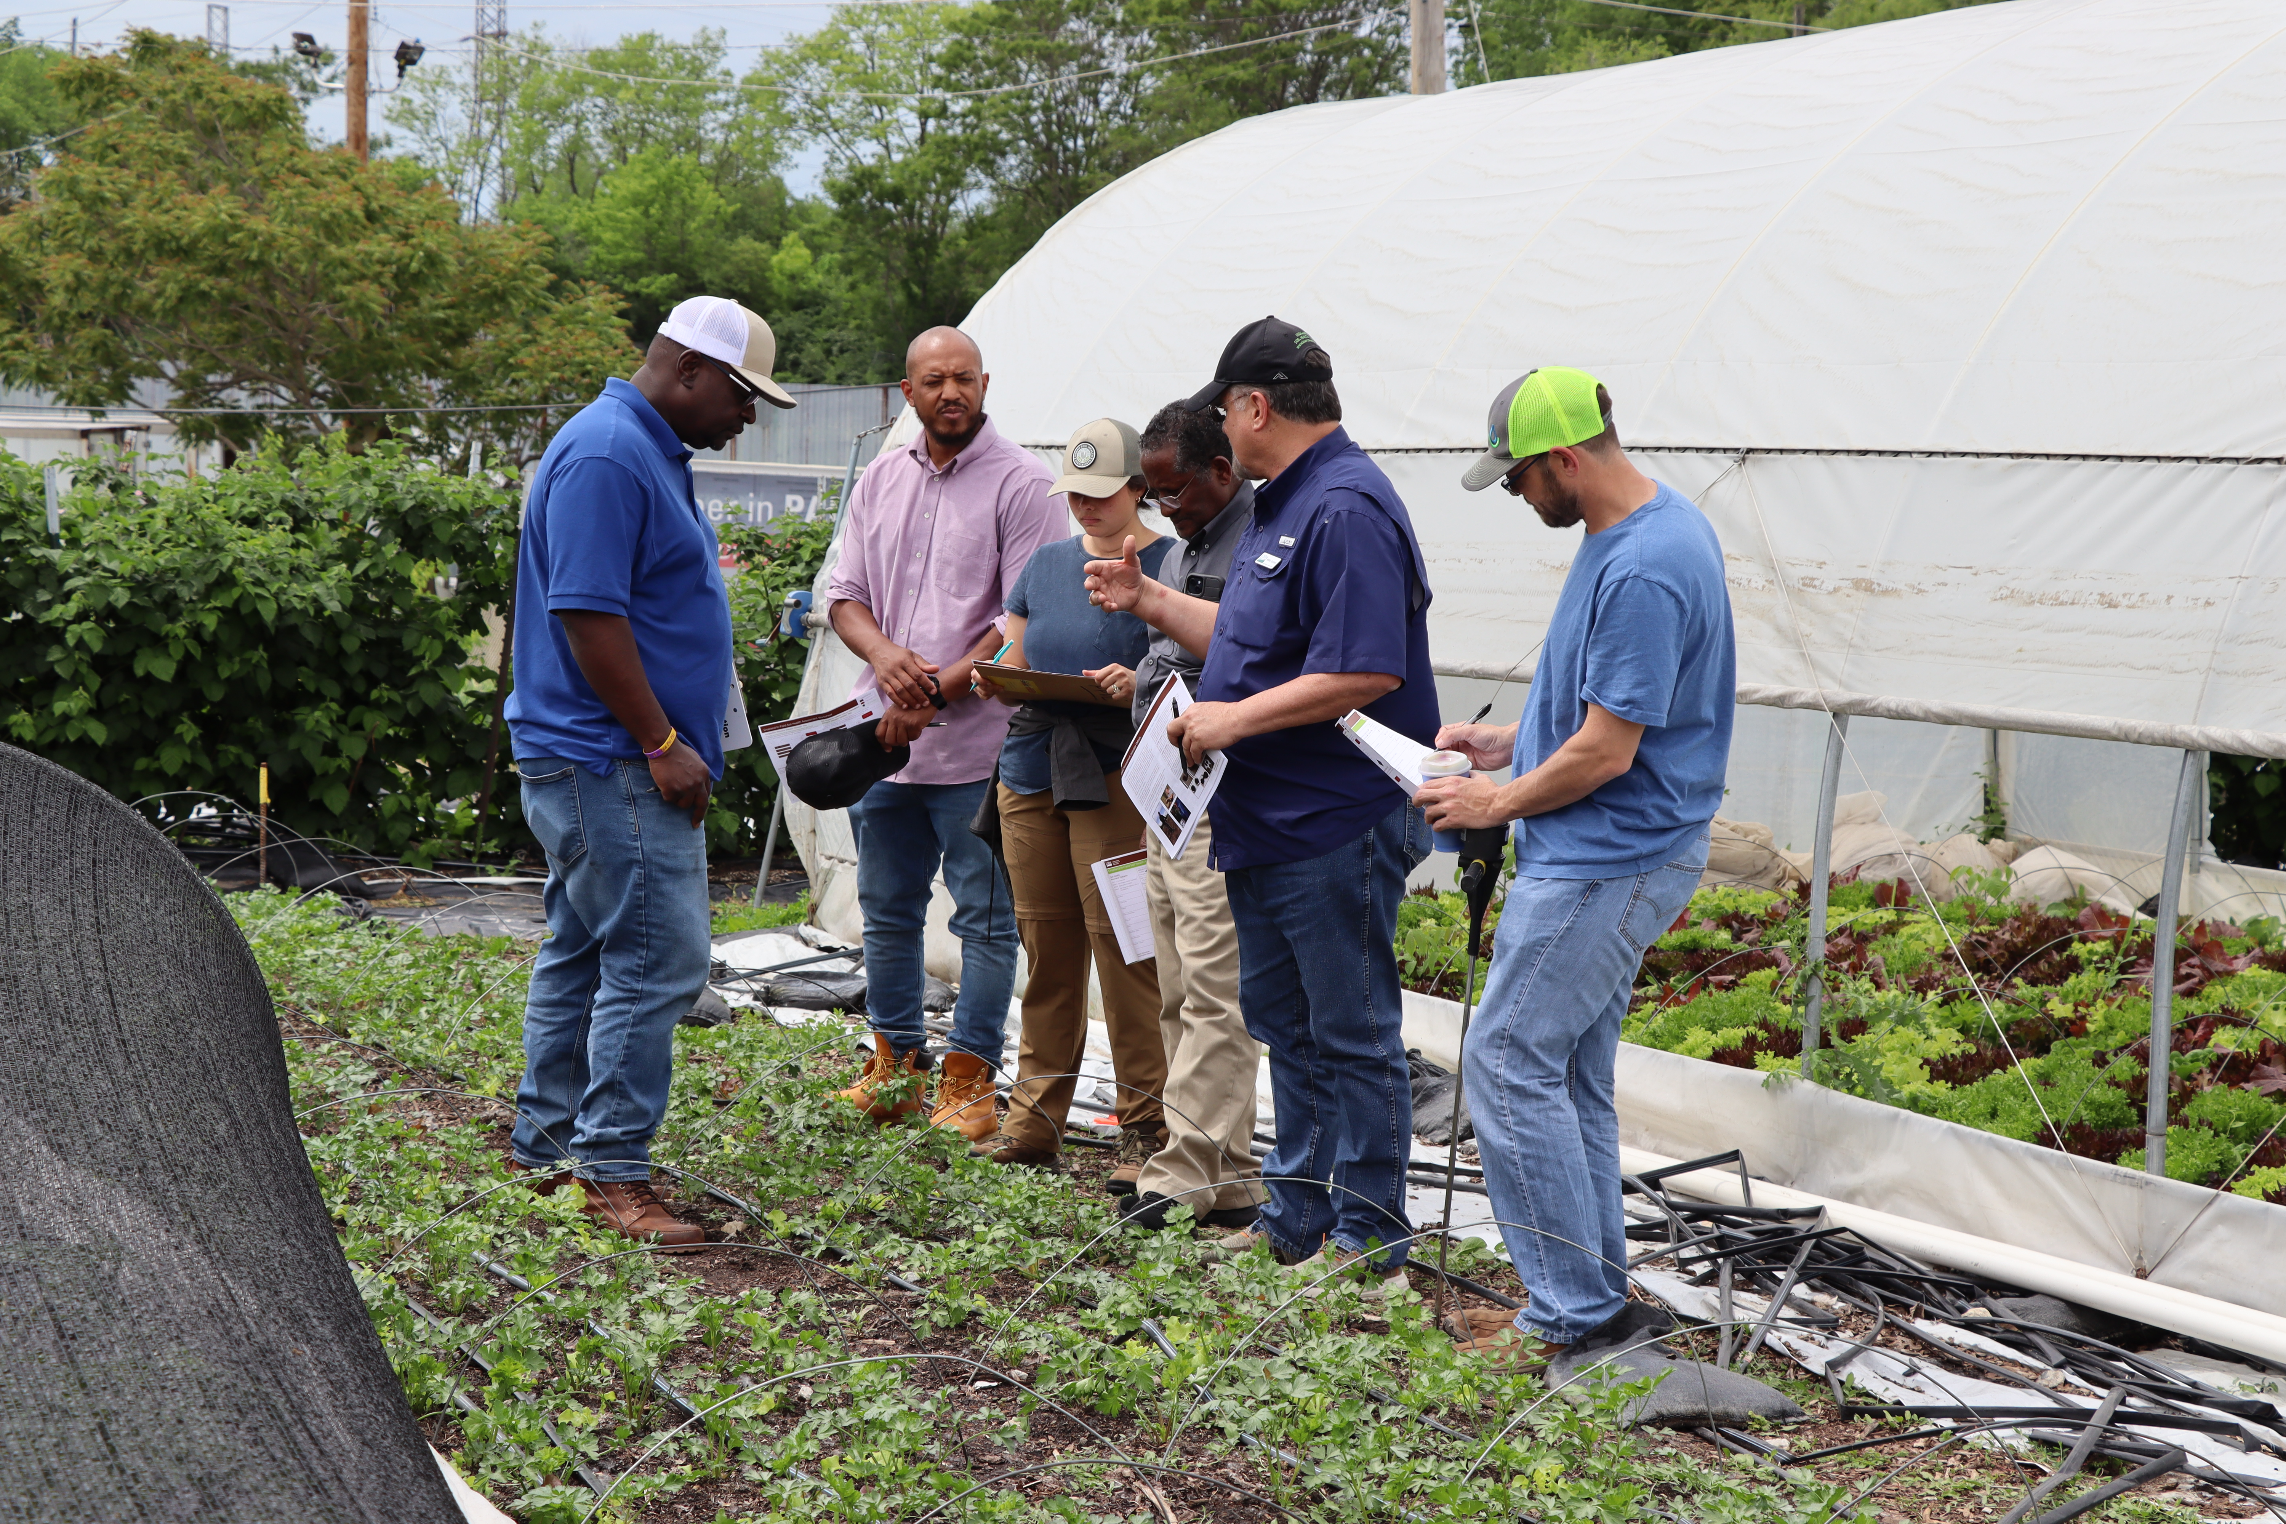
Soil Health for Small-scale Agriculture – Training
Enter your location and date
Notes:
Now let's look at an overview of the agenda for our time together in this training over the next three days.
Photo: Josh Beniston, USDA NRCS. NRCS staff working a Cropland In-Field Soil Health Assessment at an urban market garden in Indianapolis IN, uding the May 2024 pilot of this training.

Slide 25
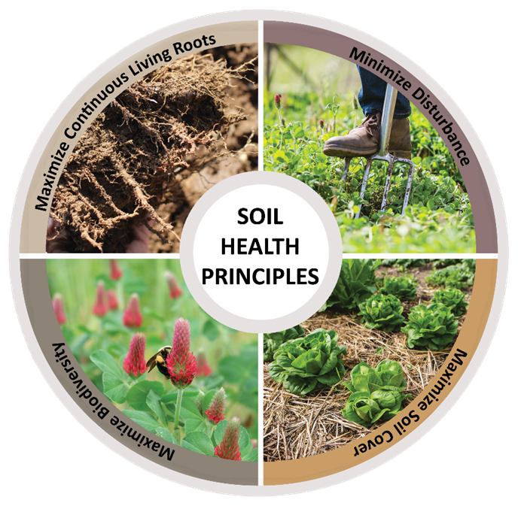
This Training - Agenda
Soil Health
  Soil Biology Review
  Resource Concerns
  Site Evaluation
  Nutrient Management
Conservation Practices
  Minimize Disturbance (329, 345, 812)
  Maximize Cover (484)
  Maximize Diversity (328, 420)
  Maximize Living Roots (340)
  Soil Carbon (336)
Notes:
As advertised, we will get into the details of soil health for small scale and urban agriculture. This will include a few modules on the assessment of soil health including resource concerns and site evaluation. We will also spend time discussing small scale soil health management by looking at how conservation practices can be applied at small scales including reducing tillage, developing soil building cover crop rotations, small scale cover cropping, and the use of soil carbon amendments for small scale agriculture. Our focus in these modules will be the ways in which producers can apply these practices using techniques that are designed for small scale systems, and we will also look at how each of these practices can lead to enhancements in the soil ecosystem.
Image: NRCS Indiana

Slide 26
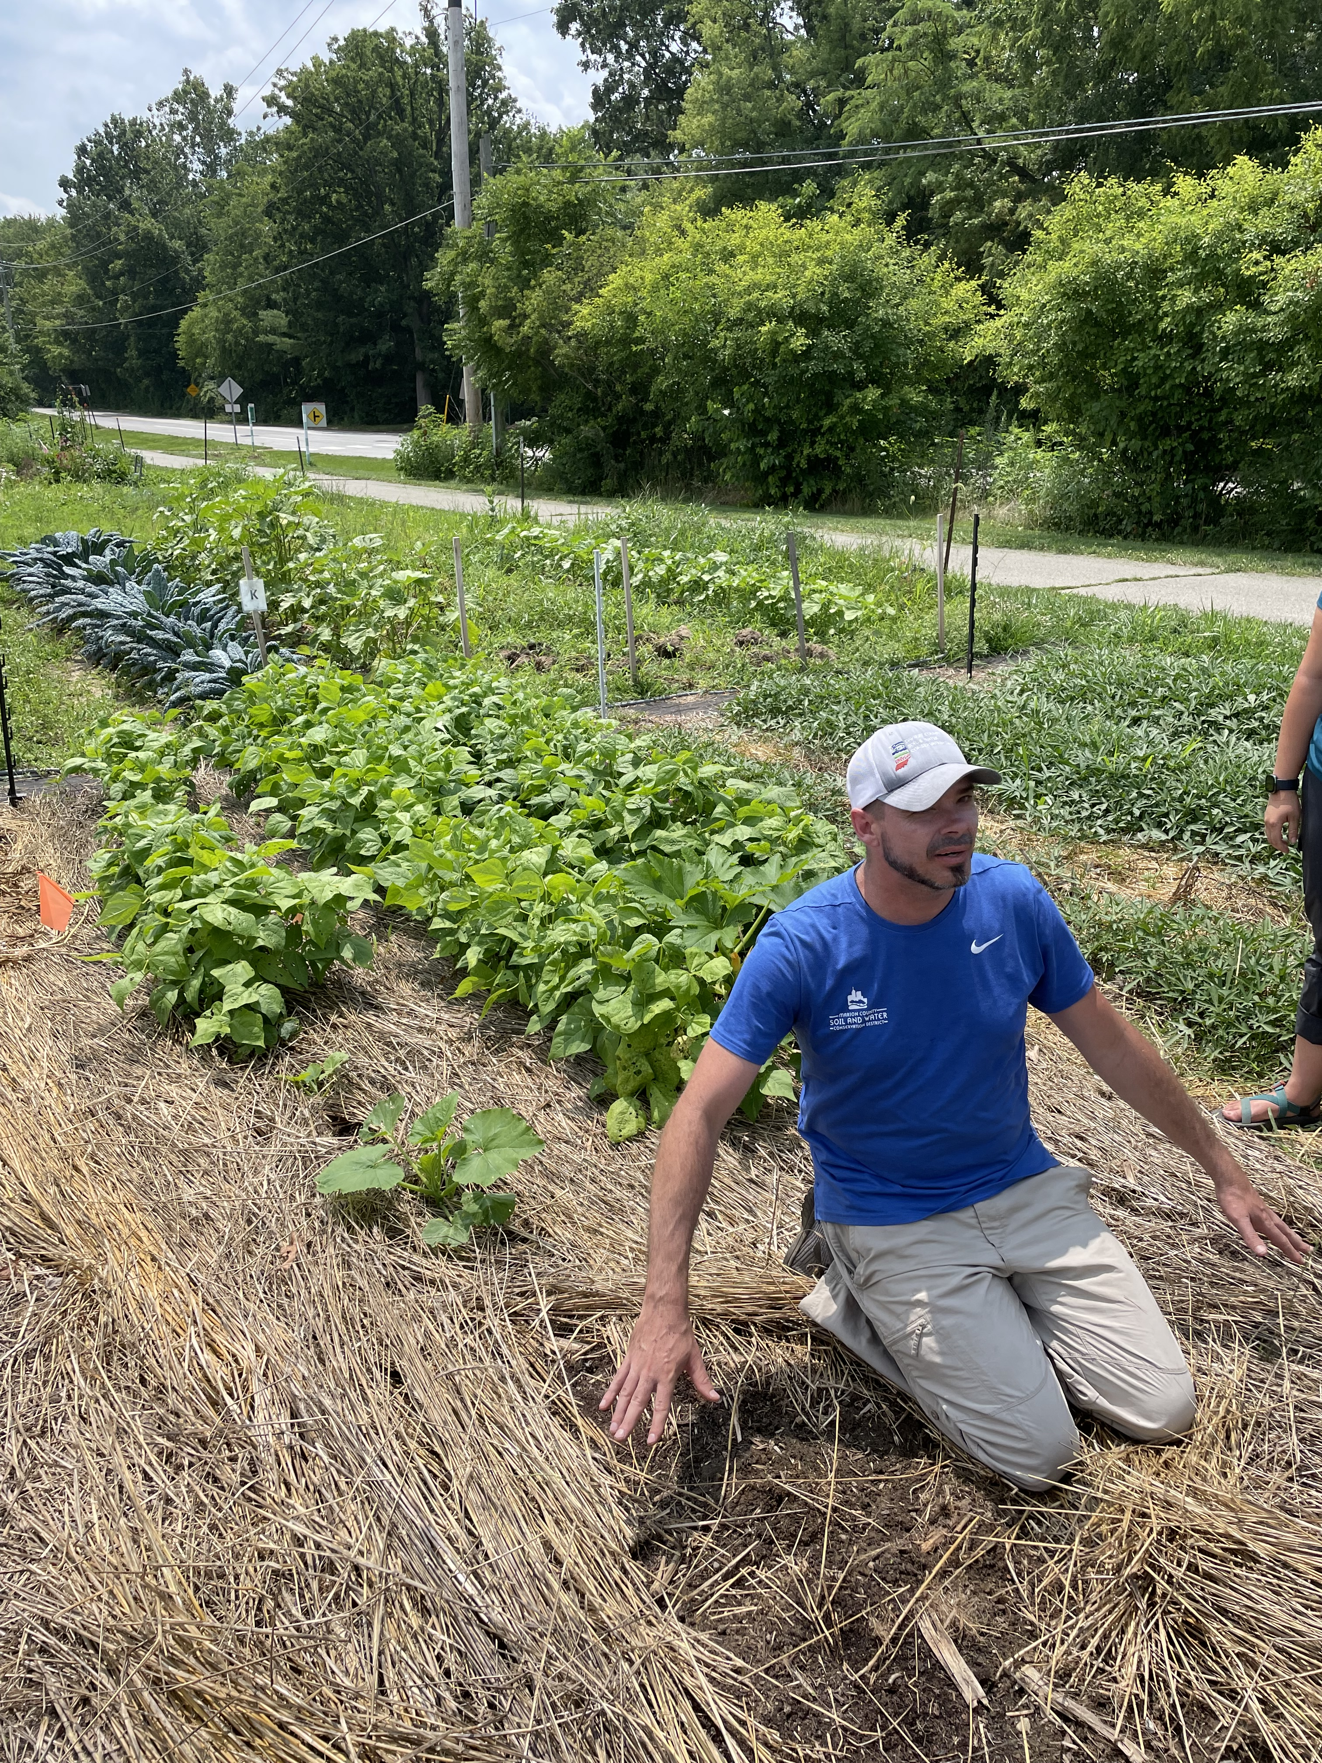
This Training - Agenda
Field visits
  Community College Farm
  Urban Farms
  Soil Health Assessment
Tools and resources for small-scale conservation planning.
Group project
Notes:
Use this slide to describe the field activities and site visits that will be a part of the training.
Photo by Josh Beniston, USDA NRCS. Kevin Allison, urban conservationist at the Marion County soil and water conservation district in Indianapolis IN, demonstrates the use of cover crop residues as mulch in his urban soil health demonstration garden.

Slide 27
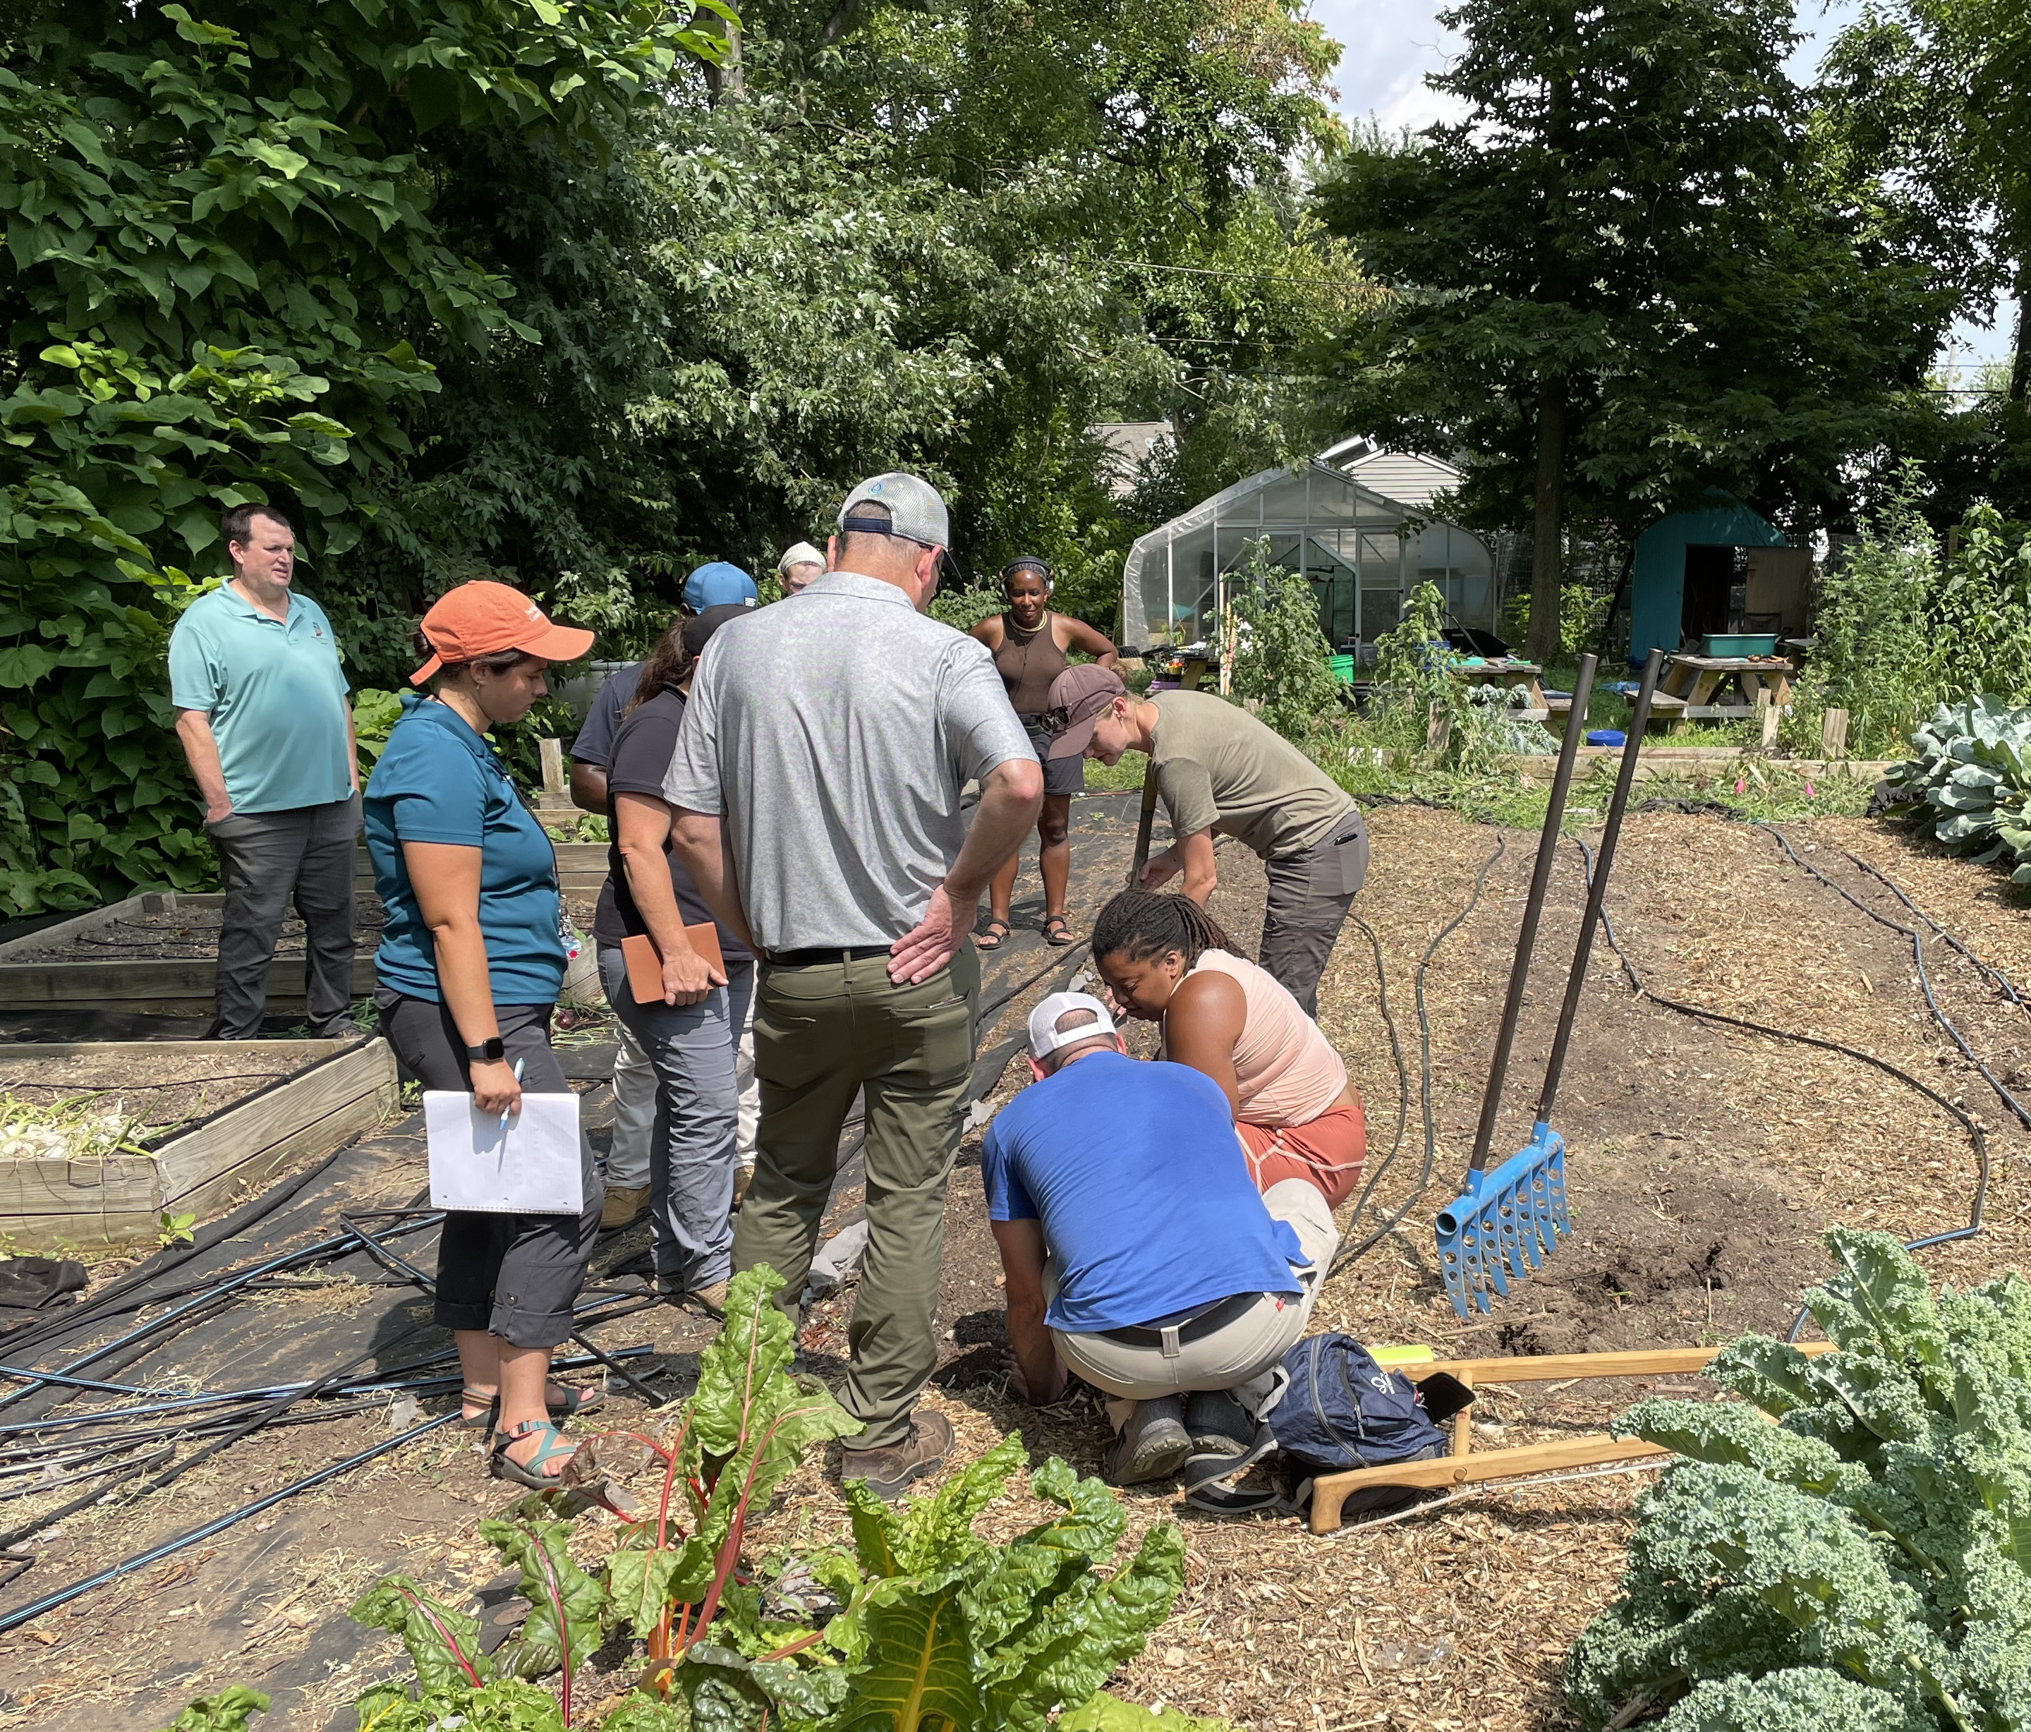
This Training
Notes:
Fill in any other important details about the particular training.
Photo: Josh Beniston, USDA NRCS. NRCS staff and conservation district partners discussing soil health with an urban producer and her farm staff in Indianapolis, IN.

Slide 28
Introducing Group Projects

Slide 29
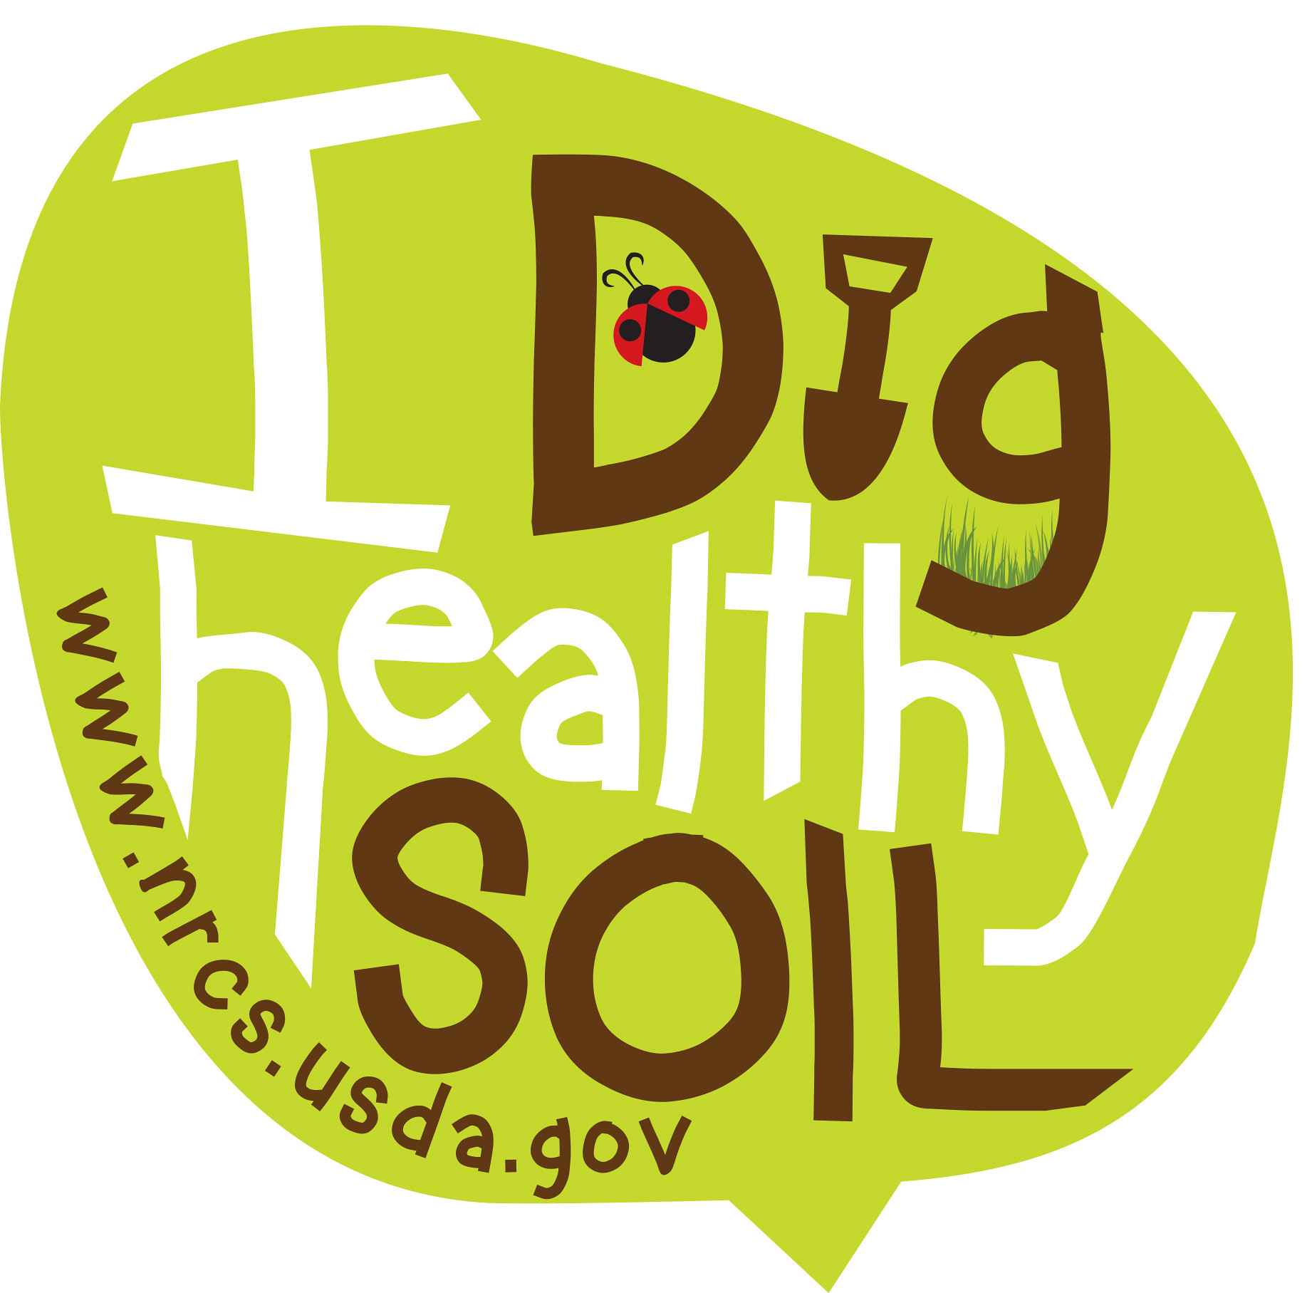
Questions and Review
Thank you for participating!
joshua.beniston@usda.gov

Slide 30
Thank you!
For more information on Managing Soil Health,
visit us here:
https://www.nrcs.usda.gov/conservation-basics/natural-resource-concerns/soils/soil-health
USDA is an equal opportunity provider, employer, and lender.
Meeh, NRCS

Slide 31
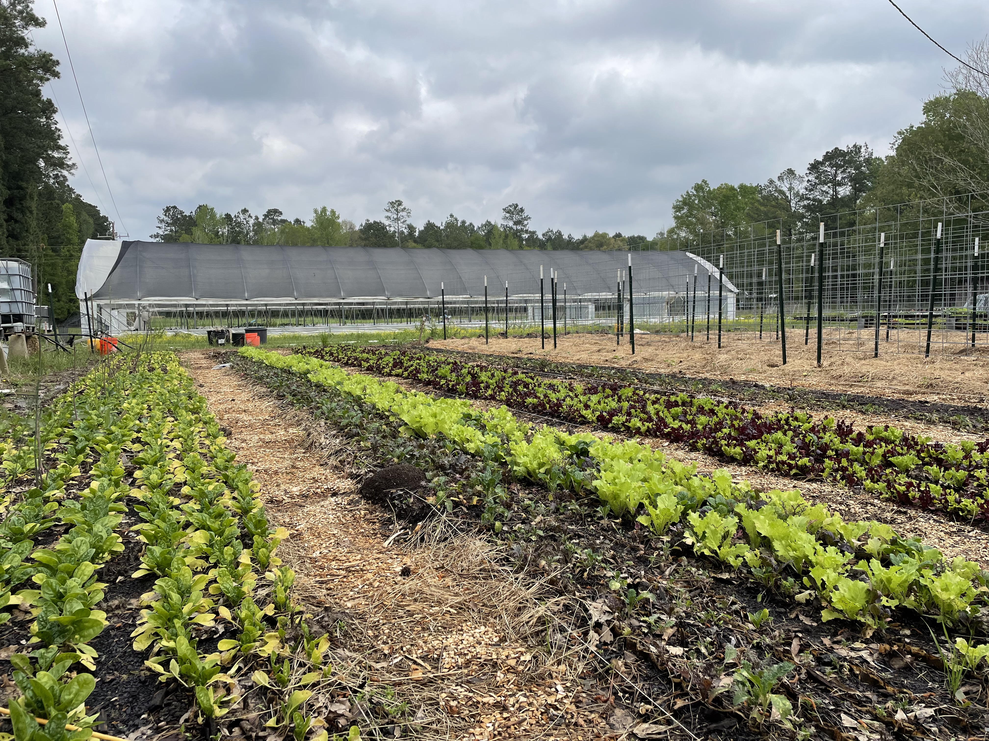
Printed Packets
Technical Documents from Indiana NRCS and Partners
Urban Soil Health Technical Notes
USDA SARE Publications
Notes:
This should be included in presentation !

Slide 32
What has NRCS accomplished in recent years ?
22% increase in conservation practices applied in urban census locations since 2021
41% increase in applications from counties associated with the 17 urban service centers from FY23 to FY 24
70 Small-Scale Scenarios for 40 Conservation Practices
Multiple interim practices
Hired State, Area, and Office Level Urban Conservationists in many states
Notes:
Data from Rob McAfee, National Urban Agriculture Coordinator, USDA NRCS

